Slide 1
Towards a Complexity Theory for Fully Quantum Problems
Henry Yuen
Columbia
Image credit: Dall-E
Notes:
This talk is going to be about trying to understand the complexity of what I call “Fully Quantum” problems; these are computational tasks where the inputs and outputs are quantum states, and appear to be quite different in nature than computational problems with classical inputs and classical outputs.
First, I’m going to try to motivate why we need such a complexity theory.
Then I’ll present pieces of what I think such a complexity theory could look like.

Slide 2
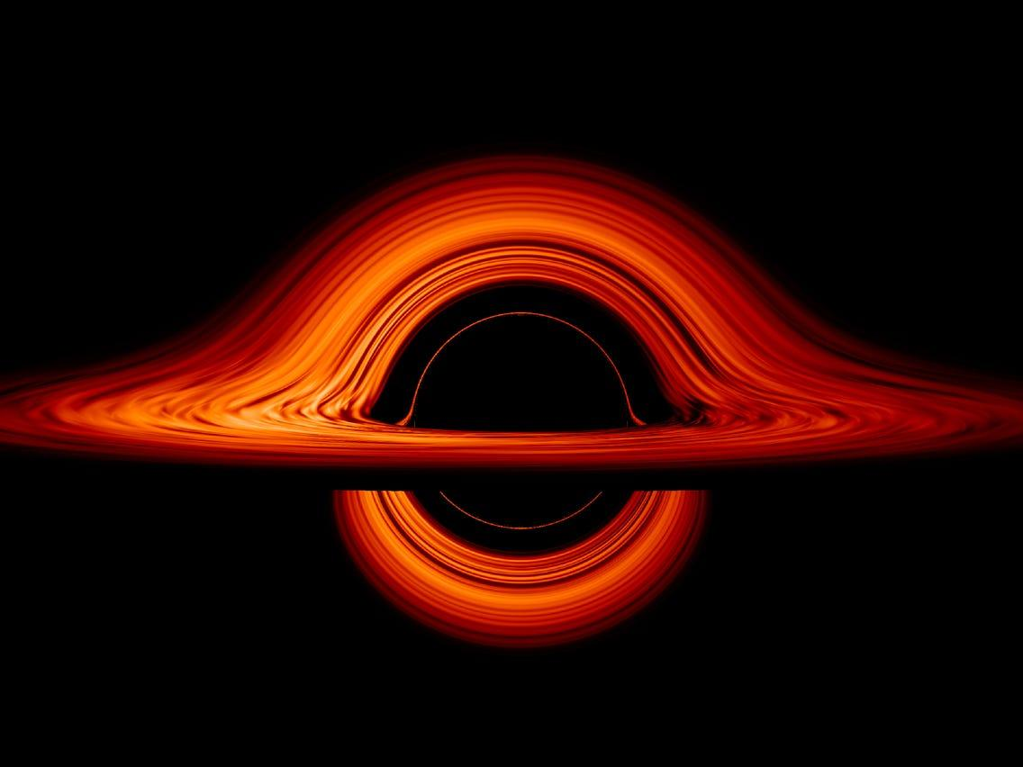
Suppose an entangled qubit is thrown into a black hole.
Radiation
Black hole
Notes:
Because this is a Quantum Information and Physics workshop I thought I’d start with this scenario, which should be familiar to many here.

Slide 3
The black hole radiates.
Radiation
Black hole
Notes:
The black hole radiates. What happens to the qubit that we threw in?

Slide 4
Hayden, Preskill: If the evolution of the black hole + radiation is unitary, then after the Page time the qubit should be recoverable (only) from the state of the radiation.
Radiation
Black hole
Harlow, Hayden: it should be computationally intractable to decode the Hawking radiation.
Notes:
Well,

Slide 5
Harlow, Hayden + Aaronson: if cryptographic one-way functions exist, then there exists a black hole + radiation state where the qubit cannot be recovered in polynomial time.
Radiation
Black hole

Slide 6
Harlow, Hayden + Aaronson: if cryptographic one-way functions exist, then there exists a black hole + radiation state where the qubit cannot be recovered in polynomial time.
Radiation
Black hole
Questions:
Can the conclusion be based on weaker (or no) assumptions?
Does this hardness hold for generic black holes?
What computational resources suffice to decode Hawking radiation?

Slide 7
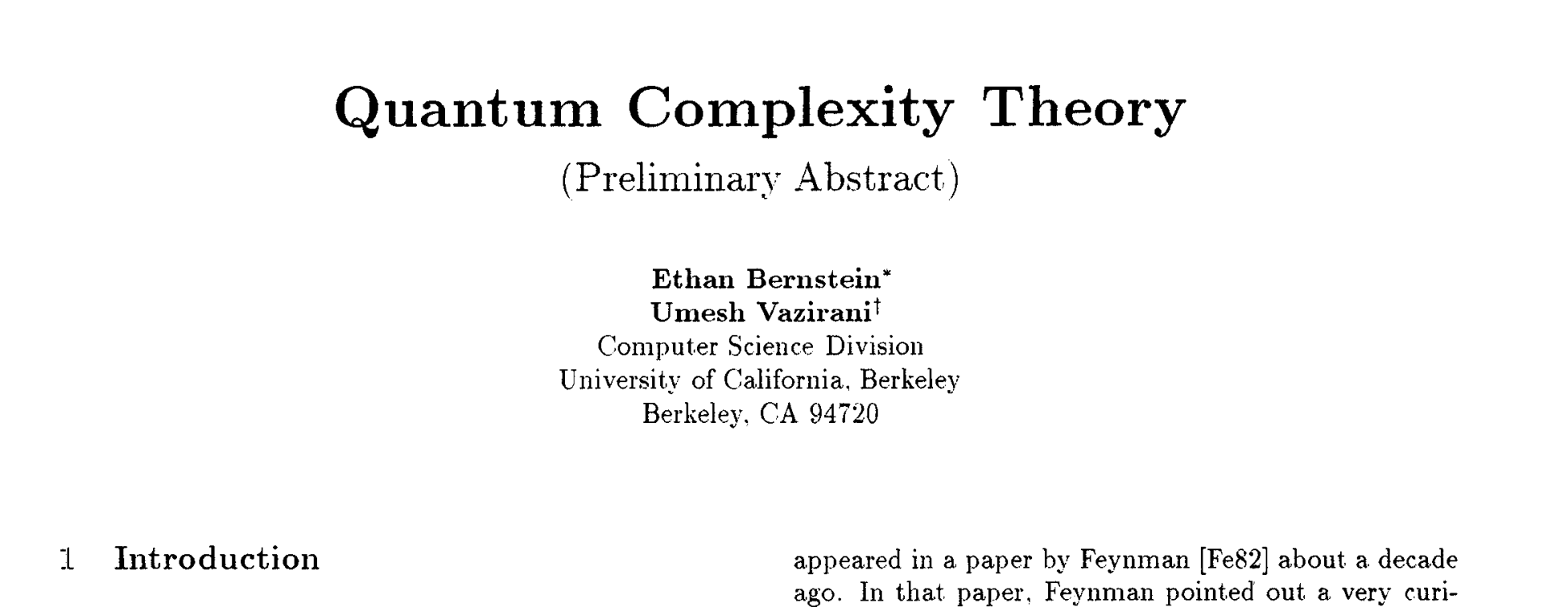
A theory to answer these questions?
Symposium on Theory of Computing 1993
Questions:
Can the conclusion be based on weaker (or no) assumptions?
Does this hardness hold for generic black holes?
What computational resources suffice to decode Hawking radiation?

Slide 8
30 years of Quantum Complexity Theory
Rich complexity classes: BQP, PostBQP, QMA, MIP*, …
Interesting computational problems: Hamiltonian simulation, approximating the Jones polynomial, ground energy estimation, …
Insights into other fields: Hamiltonian complexity and condensed matter, quantum interactive proofs and operator algebras, …
Foundations of quantum advantage: BosonSampling, Random Circuit Sampling, complexity-theoretic evidence for quantum supremacy, …
Notes:
It’s a field that’s flourished over the last 30 years. It’s given us fascinating complexity classes to play with, interesting computational problems, deep insights into other fields like condensed matter physics or pure mathematics, and has provided a rigorous foundation to examine when quantum computers outperform classical computers.

Slide 9
30 years of Quantum Complexity Theory
A theory of “classical input/classical output” problems
Classical
Input
Classical
Output
Quantum
Model of Computation
Notes:
At its core though, even though Quantum Complexity Theory has the word “quantum” in it, it’s largely a theory of classical in/classical out problems. The quantum part refers to the model of quantum computation we’re using. For example..

Slide 10
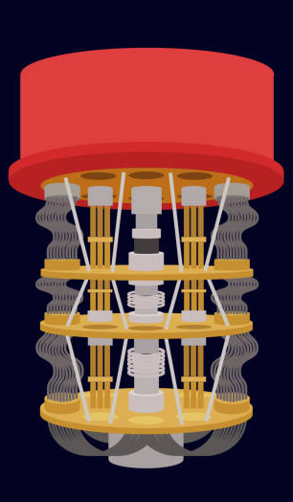
30 years of Quantum Complexity Theory
A theory of “classical input/classical output” problems
Example: Factoring
Integer N
Factors p, q
Quantum Computer
Notes:
We all know that quantum computers should be good at factoring. But factoring itself is a classical input/classical output problem: the input is a number, and the output is two numbers.

Slide 11
30 years of Quantum Complexity Theory
A theory of “classical input/classical output” problems
Example: Local Hamiltonians problem
$$\left|ψ\right\rangle$$
Local Hamiltonian H
Ground energy ± ℇ
QMA verifier-prover protocol
Notes:
Another important problem that is studied in quantum complexity theory is the local Hamiltonians problem, which you can think of as the quantum version of 3SAT. The input to the problem is a local Hamiltonian (which is a string describing some quantum many-body system), and the output is a number, which is an estimate of the minimum energy of the Hamiltonian. Here, the model of computation is not a quantum computer per se, because we don’t expect this problem to be solvable in polynomial time, but instead it is efficiently solvable in the QMA verifier-prover model of computation, which is the quantum analogue of NP.

Slide 12
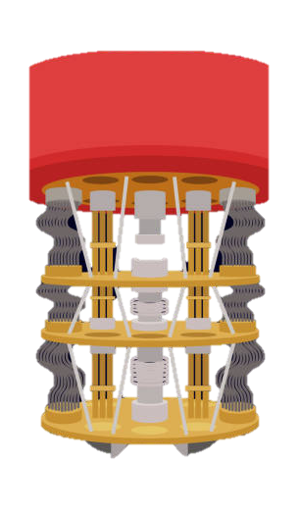
With classical input/classical output problems, we can compare classical vs quantum models of computation.
It also allows us to connect Quantum Complexity Theory with Classical Complexity Theory.
e.g., “BosonSampling is hard for classical computers unless the polynomial hierarchy collapses”
Notes:
And it makes a lot of sense to think about classical input/classical output problems: this is how we can meaningfully compare classical vs quantum models of computation. Classical computers, by definition, can only get classical inputs and produce classical outputs. And it also allows us to connect Quantum Complexity Theory with the enormous body of Classical Complexity Theory. This has been extremely useful for quantum supremacy theorems, which establish things like BosonSampling is…

Slide 13
Quantum in, quantum out
We live in a quantum universe, with quantum computations that
don’t even make sense on classical computers.
Notes:
However, as we look towards the Quantum Age, we’ll be talking more about computational tasks that don’t make sense to do on a classical computer.

Slide 14
Quantum in, quantum out
We live in a quantum universe, with quantum computations that
don’t even make sense on classical computers.
Example: Preparing complex quantum states
Local Hamiltonian H
Ground state of H
Quantum Computer

Slide 15
Quantum in, quantum out
We live in a quantum universe, with quantum computations that
don’t even make sense on classical computers.
Example: Classifying quantum phases of matter
Quantum state in unknown phase
Phase label
Quantum Computer

Slide 16
Quantum in, quantum out
We live in a quantum universe, with quantum computations that
don’t even make sense on classical computers.
Example: Decoding Hawking radiation
Black hole radiation
Qubit tossed into black hole long ago
Quantum Computer

Slide 17
Quantum in, quantum out
These are “Fully Quantum” tasks.
Can Quantum Complexity Theory explain when they are easy?
Or when they are hard?

Slide 18
Quantum in, quantum out
These are “Fully Quantum” tasks.
Can Quantum Complexity Theory explain when they are easy?
Or when they are hard?
Recently, Quantum Complexity Theory has started looking incomplete.

Slide 19
The story of quantum bit commitments

Slide 20
Bit commitments
Cryptographic analogue of putting a message in a sealed envelope that is opened later. A commitment protocol involves two phases, commit and reveal.
Commit phase: receiver obtains commitment $c$ to a bit $b$.
Hiding security: commitment c does not reveal bit b to receiver.
Bit $b$
…
commitment $c$
Committer
Receiver

Slide 21
Bit commitments
Cryptographic analogue of putting a message in a sealed envelope that is opened later. A commitment protocol involves two phases, commit and reveal.
Reveal phase: committer opens commitment c to reveal b.
Binding security: committer cannot open to opposite bit 1 – b.
Bit $b$
$$b$$
…
Committer
Receiver

Slide 22
Security of commitments
Commitments are fundamental, used in multiparty computation and zero-knowledge protocols.

Slide 23
Security of commitments
Commitments are fundamental, used in multiparty computation and zero-knowledge protocols.
The security of commitments requires some computational assumptions, e.g. P ≠ NP.
If both parties can solve NP-complete problems, either Hiding security or Binding security (or both) can be broken…

Slide 24
Security of commitments
Commitments are fundamental, used in multiparty computation and zero-knowledge protocols.
The security of commitments requires some computational assumptions, e.g. P ≠ NP.
If both parties can solve NP-complete problems, either Hiding security or Binding security (or both) can be broken… …at least, if the scheme is classical.

Slide 25
Quantum bit commitments
What if the scheme takes advantage of quantum physics?
Commit phase: Committer, receiver exchange quantum messages. Afterwards, they can be entangled.
Committer
Receiver
Hiding security: receiver cannot learn b by measuring her quantum state.

Slide 26
Quantum bit commitments
What if the scheme takes advantage of quantum physics?
Reveal phase: they exchange more quantum messages. Afterwards, receiver measures her state to verify commitment to b.
Committer
Receiver
Binding security: even if committer deviates from the protocol, receiver accepts 1 - b with very small probability.

Slide 27
Quantum bit commitments
In 1980s, cryptographers were fascinated by the possibility of unconditionally secure quantum commitment schemes.
This was motivated by quantum key distribution (QKD), whose security is based only “on the laws of quantum physics”, rather than unproven complexity conjectures.
Some researchers (1993): We found it!
Lo, Chau/Mayers (1996): No you didn’t.

Slide 28
Quantum bit commitments
Lo, Chau/Mayers 1996: The security of commitment schemes (even quantum ones) must rely on computational assumptions.

Slide 29
Lo, Chau/Mayers argument
$|ψ_{b}⟩$ = joint quantum state after commit phase, where committer commits to b
$ρ_{b}$ = receiver’s marginal state on $|ψ_{b}⟩$
Receiver’s marginal state $ρ_{b}$
Committer
Receiver
Joint state $|ψ_{b}⟩$

Slide 30
Lo, Chau/Mayers argument
Suppose, for contradiction, that both Hiding and Binding security do not require computational assumptions.
Hiding security $⟹$ $ρ_{0}$ and $ρ_{1}$ cannot be distinguished by any measurement.
Receiver’s marginal state $ρ_{b}$
Committer
Receiver
Joint state $|ψ_{b}⟩$

Slide 31
Uhlmann’s theorem
If $\left|ψ_{0}\right\rangle ,|ψ_{1}⟩$ are quantum states on systems AB with indistinguishable marginals $ρ_{0}≈ρ_{1}$ on system B, then there is a unitary $U$ acting on system A where
$$U⊗I \left|ψ_{0}\right\rangle ≈|ψ_{1}⟩$$
Uhlmann transformation on A
Uhlmann’s theorem is central in quantum information: it quantifies how well one can locally transform one entangled state into another.

Slide 32
Lo, Chau/Mayers argument
Hiding security $⟹$ $ρ_{0}≈ρ_{1}$
Uhlmann’s theorem $⟹$ before running Reveal phase, committer can first implement an Uhlmann transformation $U$ to locally map $\left|ψ_{b}\right\rangle$ to $\left|ψ_{1−b}\right\rangle .$
Receiver’s marginal state $ρ_{b}$
Committer
Receiver
Joint state $|ψ_{b}⟩$

Slide 33
Lo, Chau/Mayers argument
Hiding security $⟹$ $ρ_{0}≈ρ_{1}$
Uhlmann’s theorem $⟹$ before running Reveal phase, committer can first implement an Uhlmann transformation $U$ to locally map $\left|ψ_{b}\right\rangle$ to $\left|ψ_{1−b}\right\rangle .$
After the Reveal phase, receiver is convinced the bit is $1−b$.
This violates Binding security; contradiction!
Committer
Receiver
Joint state $|ψ_{1−b}⟩$

Slide 34
Complexity of Uhlmann transformations
Uhlmann transformations is a “Fully Quantum” task: Given input system A of $\left|ψ_{0}\right\rangle ,$ apply transformation $U$ so state of global AB system becomes $|ψ_{1}⟩$.
What are the computational resources needed for this?
Can we relate the complexity of Uhlmann transformations to complexity of other tasks?

Slide 35
Complexity of Uhlmann transformations
Based on classical cryptography we expect Uhlmann transformations to be difficult.
Inverting one-way functions
Breaking commitment schemes
Implementing Uhlmann transformations
$$≤$$
$$≤$$
Classical commitment construction from OWFs (e.g. Naor 1991)
Lo, Chau / Mayers (1996)
A $≤$ B : “A is easy if B is easy”

Slide 36
Complexity of Uhlmann transformations
What about upper bounds on their complexity?
?
Breaking commitment schemes
Implementing Uhlmann transformations
NP
$$≤$$
$$≤$$
Not clear how Uhlmann transformations reduce to classical search problems with efficient verification…
A $≤$ B : “A is easy if B is easy”

Slide 37
Complexity of Uhlmann transformations
What about upper bounds on their complexity?
?
Breaking commitment schemes
Implementing Uhlmann transformations
EXP
$$≤$$
$$≤$$
Something funny is going on… EXP could mean multiple things.
A $≤$ B : “A is easy if B is easy”

Slide 38
Complexity of Uhlmann transformations
What about upper bounds on their complexity?
Breaking commitment schemes
Implementing Uhlmann transformations
EXP, as in actually having exponential time
$$≤$$
$$≤$$
Fact: Uhlmann transformations can be implemented by a quantum computer in exponential time.
A $≤$ B : “A is easy if B is easy”

Slide 39
Complexity of Uhlmann transformations
What about upper bounds on their complexity?
EXP, the class of decision problems solvable by exponential-time Turing machines.
?
Breaking commitment schemes
Implementing Uhlmann transformations
$$≤$$
$$≤$$
Can Uhlmann transformations be efficiently implemented with oracle access to an EXP-complete decision problem?
A $≤$ B : “A is easy if B is easy”

Slide 40
Complexity of Uhlmann transformations
What about upper bounds on their complexity?
?!
Breaking commitment schemes
Implementing Uhlmann transformations
Halting Problem
$$≤$$
$$≤$$
Can Uhlmann transformations be efficiently implemented with oracle access to the Halting problem?
A $≤$ B : “A is easy if B is easy”

Slide 41
Unitary Synthesis Question
Aaronson and Kuperberg 2007: Can every $n$-qubit unitary $U$be implemented by some poly-time quantum algorithm that queries a Boolean function$f_{U}:{\left\{0,1\right\}}^{poly(n)}→\{0,1\}$?
The function $f_{U}$ can depend on $U$ arbitrarily, and can be arbitrarily complex.

Slide 42
Unitary Synthesis Question
Aaronson and Kuperberg 2007: Can every $n$-qubit unitary $U$be implemented by some poly-time quantum algorithm that queries a Boolean function$f_{U}:{\left\{0,1\right\}}^{poly(n)}→\{0,1\}$?
The function $f_{U}$ can depend on $U$ arbitrarily, and can be arbitrarily complex.
In other words, can all of $U$’s complexity be “pushed” into the complexity of some decision problem?

Slide 43
Unitary Synthesis Question
Aaronson and Kuperberg 2007: Can every $n$-qubit unitary $U$be implemented by some poly-time quantum algorithm that queries a Boolean function$f_{U}:{\left\{0,1\right\}}^{poly(n)}→\{0,1\}$?
Conjecture: No

Slide 44
Unitary Synthesis Question
Aaronson and Kuperberg 2007: Can every $n$-qubit unitary $U$be implemented by some poly-time quantum algorithm that queries a Boolean function$f_{U}:{\left\{0,1\right\}}^{poly(n)}→\{0,1\}$?
Conjecture: No
Some non-trivial progress: [Lombardi, Ma, Wright 2023] showed efficient Unitary Synthesis is not possible for 1-query algorithms!

Slide 45
Quantum in, quantum out is different
No-cloning theorem, fragility of quantum information makes quantum input/quantum output problems fundamentally different from classical computation tasks.
Since the algorithm doesn’t have a classical description of input, it doesn’t have a classical description of output.
Thus oracle access to classical functions – even fantastically complex ones – doesn’t seem to help ”shortcut” a difficult quantum transformation.

Slide 46
Other evidence
No search-to-decision reductions for QMA (“quantum NP”)
If ground energy estimation is easy, is ground state preparation easy?
Some evidence the answer is “No”.
Even if P = NP, computationally-secure quantum cryptography can still exist.
[Irani, Rao, Natarajan, Nirkhe, Yuen ‘21]
[Kretschmer ‘21], [Kretschmer, Qian, Sinha, Tal ‘23]

Slide 47
Summary so far
In the Quantum Universe, there are interesting computational problems with quantum inputs and quantum outputs.
Traditional complexity theory of decision problems does not seem to be the right framework to reason about quantum cryptography.
Lack of search-to-decision, quantum cryptography in Algorithmica, and the Unitary Synthesis Question suggest we need a “fully quantum” complexity theory for “fully quantum” computational problems.

Slide 48
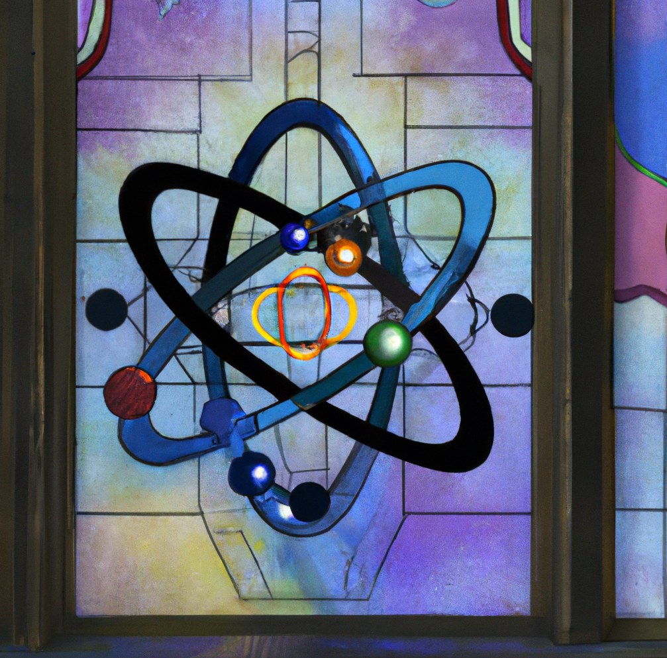
Goals of a new complexity theory
Identify natural quantum tasks from the sciences.
condensed matter physics, high energy physics, chemistry, computer science, cryptography, optimization, experimental physics,…
Show reductions between them
Classify them by complexity
Identify complete problems
Prove separations
Use hardness for cryptography
Next: an illustration of these goals

Slide 49
Let’s go on safari…
Quantum state compression
Decoding noisy quantum channels
Uhlmann Transformations
Unscrambling the Hawking radiation of a black hole
Breaking quantum cryptography
Optimal prover strategies in a quantum interactive proof

Slide 50
Unitary synthesis problems
A unitary synthesis problem is a family of unitary transformations ${𝒰=\left(U_{x}\right)}_{x∈{\left\{0,1\right\}}^{∗}}$.
Unitary specification $x$
Quantum input $|θ⟩$
Quantum output $U_{x}|θ⟩$
Quantum Model of Computation
Notes:
I’m going to focus on something I call the Uhlmann Transformation Problem, which is based on Uhlmann’s Theorem, which probably many of you know. The simplest version of it says this: let’s say you have two purifications…
The Uhlmann Transformation Problem is the following problem…
Does this make sense to everyone?

Slide 51
Unitary synthesis problems
A quantum model of computation implements $𝒰$ if given specification $x$ and quantum input $|θ⟩$, approximately outputs $U_{x}|θ⟩$.
Unitary specification $x$
Complexity is measured as a function of length of $x$ and $\left|θ\right\rangle$.
Quantum input $|θ⟩$
Quantum output $U_{x}|θ⟩$
Quantum Model of Computation
Notes:
I’m going to focus on something I call the Uhlmann Transformation Problem, which is based on Uhlmann’s Theorem, which probably many of you know. The simplest version of it says this: let’s say you have two purifications…
The Uhlmann Transformation Problem is the following problem…
Does this make sense to everyone?

Slide 52
Unitary complexity theory
A unitary complexity class is a collection of unitary synthesis problems.
unitaryPSPACE: unitary synthesis problems implementable by polynomial-space algorithms.
unitaryBQP: unitary synthesis problems implementable by polynomial-time algorithms.

Slide 53
Reductions
A unitary synthesis problem $𝒰=\left(U_{x}\right)$ polynomial-time reduces to $𝒱=\left(V_{y}\right)$if there is a poly-time algorithm that queries $𝒱$ and implements $𝒰$.
i.e. “If $𝒱$ is easy, then $𝒰$ is easy.”
Unitary specification $x$
$$V_{y}$$
$$V_{y}$$
Quantum input $|θ⟩$
$$V_{y}$$
$$U_{x}|θ⟩$$
$$V_{y}$$
$$V_{y}$$
Polynomial-time query algorithm
Notes:
I’m going to focus on something I call the Uhlmann Transformation Problem, which is based on Uhlmann’s Theorem, which probably many of you know. The simplest version of it says this: let’s say you have two purifications…
The Uhlmann Transformation Problem is the following problem…
Does this make sense to everyone?

Slide 54
Uhlmann Transformation Problem
An example of a unitary synthesis problem.
Uhlmann ${=\left(U_{x}\right)}_{x∈{\left\{0,1\right\}}^{∗}}$ where $x=$ circuit descriptions of bipartite $\left|ψ_{0}\right\rangle ,\left|ψ_{1}\right\rangle$, and $U_{x}$ is the corresponding Uhlmann transformation.
(
)
$$\left|ψ_{0}\right\rangle$$
A
,
$$\left|ψ_{1}\right\rangle$$
A
$$U_{x}⊗I\left|ψ_{0}\right\rangle ≈|ψ_{1}⟩$$
$x$ =
specifies
B
B
Notes:
I’m going to focus on something I call the Uhlmann Transformation Problem, which is based on Uhlmann’s Theorem, which probably many of you know. The simplest version of it says this: let’s say you have two purifications…
The Uhlmann Transformation Problem is the following problem…
Does this make sense to everyone?

Slide 55
Let’s do some complexity theory!
Based on works with: Bostanci, Efron, Metger, Poremba, Qian, Rosenthal.
Disclaimer: the following Theorem statements are approximate and omit some technical details.

Slide 56
Quantum state compression
Decoding noisy quantum channels
Uhlmann
Unscrambling the Hawking radiation of a black hole
Breaking quantum commitments
Optimal prover strategies in a quantum interactive proof

Slide 57
Theorem: Uhlmann $∈$ unitaryBQP $⇔$ Harlow-Hayden $∈$unitaryBQP.
Quantum state compression
Decoding noisy quantum channels
Uhlmann
Unscrambling the Hawking radiation of a black hole
Breaking quantum cryptography
Optimal prover strategies in a quantum interactive proof

Slide 58
Quantum state compression
Decoding noisy quantum channels
Uhlmann
Unscrambling the Hawking radiation of a black hole
Breaking quantum commitments
Theorem: Uhlmann $∈$ unitaryBQP $⇔$ Commitment-Breaking $∈$ unitaryBQP
Optimal prover strategies in a quantum interactive proof

Slide 59
Quantum state compression
Decoding noisy quantum channels
Uhlmann
Unscrambling the Hawking radiation of a black hole
Breaking quantum commitments
Theorem: Uhlmann $∈$ unitaryBQP $⇔$ Channel-Decoding $∈$ unitaryBQP
Optimal prover strategies in a quantum interactive proof

Slide 60
Corollary: These are all computationally equivalent! See “Black-Hole Radiation Decoding is Quantum Cryptography” by Brakerski (2022).
Quantum state compression
Decoding noisy quantum channels
Uhlmann
Unscrambling the Hawking radiation of a black hole
Breaking quantum commitments
Optimal prover strategies in a quantum interactive proof

Slide 61
Theorem: If Uhlmann $∈$ unitaryBQP, then quantum states can be efficiently compressed to their entropy.
Quantum state compression
Decoding noisy quantum channels
Uhlmann
Unscrambling the Hawking radiation of a black hole
Breaking quantum commitments
Almost-converse: If quantum states can be efficiently compressed, then pseudorandom states and pseudoentangled states do not exist.
Optimal prover strategies in a quantum interactive proof
Not known to imply that Uhlmann is easy!

Slide 62
The complexity of Uhlmann
Assuming quantum-secure OWFs exist, Uhlmann $∉$ unitaryBQP.
Theorem: Uhlmann $∈$ unitaryPSPACE.
This uses techniques from Quantum Singular Value Transform. (see for Ewin Tang’s talk tomorrow)
Question: Is Uhlmann a complete problem for a natural complexity class?

Slide 63
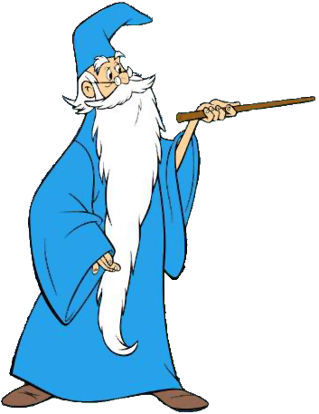
Interactive proofs for Uhlmann
Verifier’s goal: transform $|ψ_{0}⟩$ to $|ψ_{1}⟩$ via a local transformation
…by interacting with an all-powerful, but untrusted prover.
$$|ψ_{0}⟩$$
Polynomial-time verifier
All-powerful, but untrusted prover
$|ψ_{0}⟩$, $|ψ_{1}⟩$: efficiently synthesizable states where $\left|ψ_{1}\right\rangle =U⊗I|ψ_{0}⟩$

Slide 64
Interactive proofs for Uhlmann
Verifier’s goal: transform $|ψ_{0}⟩$ to $|ψ_{1}⟩$ via a local transformation
…by interacting with an all-powerful, but untrusted prover.
$$|ψ_{1}⟩$$
Polynomial-time verifier
All-powerful, but untrusted prover
$|ψ_{0}⟩$, $|ψ_{1}⟩$: efficiently synthesizable states where $\left|ψ_{1}\right\rangle =U⊗I|ψ_{0}⟩$

Slide 65
Interactive proofs for Uhlmann
$$|ψ_{0}⟩$$
Step 1:
Receive register A of $\left|ψ_{0}\right\rangle$
All-powerful, but untrusted prover
Polynomial-time verifier
$|ψ_{0}⟩$, $|ψ_{1}⟩$: efficiently synthesizable states where $\left|ψ_{1}\right\rangle =U⊗I|ψ_{0}⟩$

Slide 66
Interactive proofs for Uhlmann
“True” copy
$$|ψ_{0}⟩$$
Step 2:
Synthesize “decoy” copy of $\left|ψ_{0}\right\rangle$
$$|ψ_{0}⟩$$
“Decoy” copy
All-powerful, but untrusted prover
Polynomial-time verifier
$|ψ_{0}⟩$, $|ψ_{1}⟩$: efficiently synthesizable states where $\left|ψ_{1}\right\rangle =U⊗I|ψ_{0}⟩$

Slide 67
Interactive proofs for Uhlmann
$$|ψ_{0}⟩$$
Step 3:
Randomly permute the A registers of true and decoy copies.
$$|ψ_{0}⟩$$
All-powerful, but untrusted prover
Polynomial-time verifier
$|ψ_{0}⟩$, $|ψ_{1}⟩$: efficiently synthesizable states where $\left|ψ_{1}\right\rangle =U⊗I|ψ_{0}⟩$

Slide 68
Interactive proofs for Uhlmann
$$|ψ_{0}⟩$$
Step 4:
Send both A registers to prover, who applies some quantum operation.
$$|ψ_{0}⟩$$
All-powerful, but untrusted prover
Polynomial-time verifier
$|ψ_{0}⟩$, $|ψ_{1}⟩$: efficiently synthesizable states where $\left|ψ_{1}\right\rangle =U⊗I|ψ_{0}⟩$

Slide 69
Interactive proofs for Uhlmann
Step 5:
Prover sends back A registers, and verifier unpermutes.
All-powerful, but untrusted prover
Polynomial-time verifier
$|ψ_{0}⟩$, $|ψ_{1}⟩$: efficiently synthesizable states where $\left|ψ_{1}\right\rangle =U⊗I|ψ_{0}⟩$

Slide 70
Interactive proofs for Uhlmann
Step 6:
Verifier tests if decoy copy is now $|ψ_{1}⟩$. If so, then it accepts and outputs first half of “real” copy.
$$|ψ_{1}⟩$$
All-powerful, but untrusted prover
Polynomial-time verifier
$|ψ_{0}⟩$, $|ψ_{1}⟩$: efficiently synthesizable states where $\left|ψ_{1}\right\rangle =U⊗I|ψ_{0}⟩$

Slide 71
Interactive proofs for Uhlmann
Step 6:
Verifier tests if decoy copy is now $|ψ_{1}⟩$. If so, then it accepts and outputs first half of “real” copy.
$$|ψ_{1}⟩$$
All-powerful, but untrusted prover
Polynomial-time verifier
$|ψ_{0}⟩$, $|ψ_{1}⟩$: efficiently synthesizable states where $\left|ψ_{1}\right\rangle =U⊗I|ψ_{0}⟩$

Slide 72
Interactive proofs for Uhlmann
Conditioned on the decoy being $|ψ_{1}⟩$, the “real” copy of $\left|ψ_{0}\right\rangle$ has been (approximately) transformed to $|ψ_{1}⟩$.
$$|ψ_{1}⟩$$
All-powerful, but untrusted prover
Polynomial-time verifier
$|ψ_{0}⟩$, $|ψ_{1}⟩$: efficiently synthesizable states where $\left|ψ_{1}\right\rangle =U⊗I|ψ_{0}⟩$

Slide 73
Interactive proofs for Uhlmann
This shows that Uhlmann $∈$ unitaryQIP, the class of unitaries that can be efficiently implemented with the help of all-powerful, untrusted prover.
In fact, the interactive proof for Uhlmann is zero-knowledge, meaning that the verifier can efficiently simulate each step of the protocol (without needing a prover).
Theorem: Uhlmann is a complete problem for unitarySZK, the class of unitaries implementable with statistical zero-knowledge interactive protocols.

Slide 74
Interactive proofs for Uhlmann
Succinct-Uhlmann is variant where $\left|ψ_{0}\right\rangle ,|ψ_{1}⟩$ are not necessarily efficiently synthesizable, but have succinct descriptions.
e.g. “$\left|ψ_{0}\right\rangle$ = $e^{−iHt} |0⟩$ for exponentially large $t$”.
Theorem: Succinct-Uhlmann is complete for unitaryQIP.
Theorem: Succinct-Uhlmann is complete for unitaryPSPACE.
Corollary: unitaryQIP = unitaryPSPACE.

Slide 75
The unitary complexity landscape so far….
unitaryPSPACE = unitaryQIP
Succinct-Uhlmann
Fast-Forwarding Hamiltonian Evolution
unitarySZK
Uhlmann
Decodable Channels
Compression
Unscrambling Hawking Radiation
Breaking Commitments
unitaryBQP
Hamiltonian Evolution
Technically, this picture holds for average-case versions of the complexity classes.

Slide 76
Why (unitary) complexity theory?

Slide 77
A great lesson from complexity theory: the computational universe is much richer than just “polynomial time” vs. “non-polynomial time”.
Showing that a computational problem is complete for some natural complexity class (e.g. one defined by a computational model such as limited space, interactive proofs, post-selection, etc) illuminates the essential character of the problem.

Slide 78
Interesting questions
We would like a language to precisely and succinctly ask – and answer – questions about the complexity of Fully Quantum tasks.
e.g. can all quantum Shannon theory protocols be polynomial-time reduced to Uhlmann?
Is Hamiltonian Fast Forwarding complete for unitaryPSPACE?

Slide 79
Interesting questions
We would like a language to precisely and succinctly ask – and answer – questions about the complexity of Fully Quantum tasks.
e.g. a quantitative version of Aaronson and Kuperberg’s Unitary Synthesis Question is
Does unitaryBQP^{PSPACE} = unitaryPSPACE?
…does unitaryBQP^{HALT} $⊇$ unitaryPSPACE?

Slide 80
Interesting new models
What is contained in unitaryQMA? What is a complete problem?
unitaryQMA models the following scenario: the prover sends the verifier a polynomial-size state that helps the verifier implement a complex unitary transform.
In other words, when can a quantum state “catalyze” a difficult computation?

Slide 81
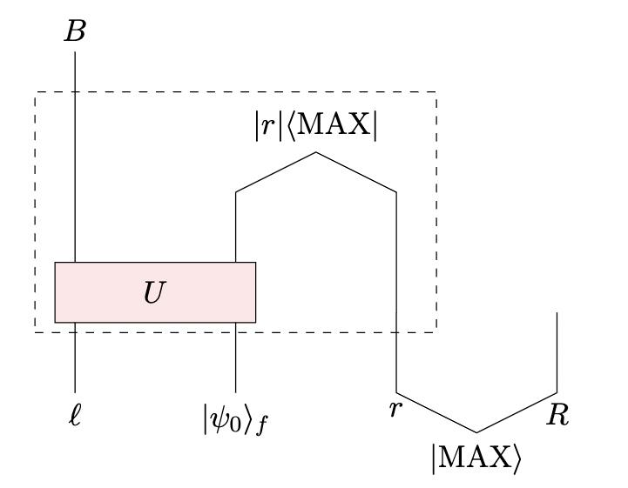
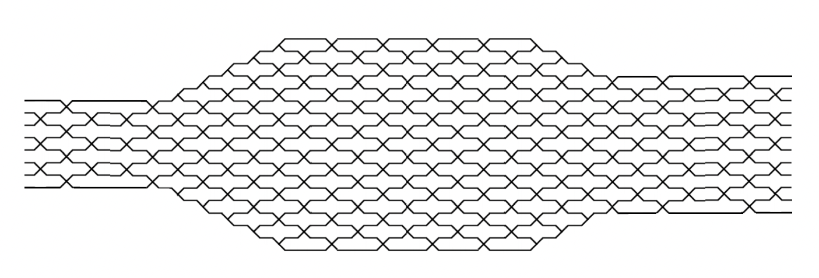
Interesting new models
Is there an interesting complexity class for “post-selected” unitaries? What is a complete problem? How does it compare to other unitary complexity classes?
The Python’s Lunch (Brown, Gharibyan, Penington, Susskind)
Unitarity of the black-hole S-matrix (Akers, et al. and Kim-Preskill)

Slide 82
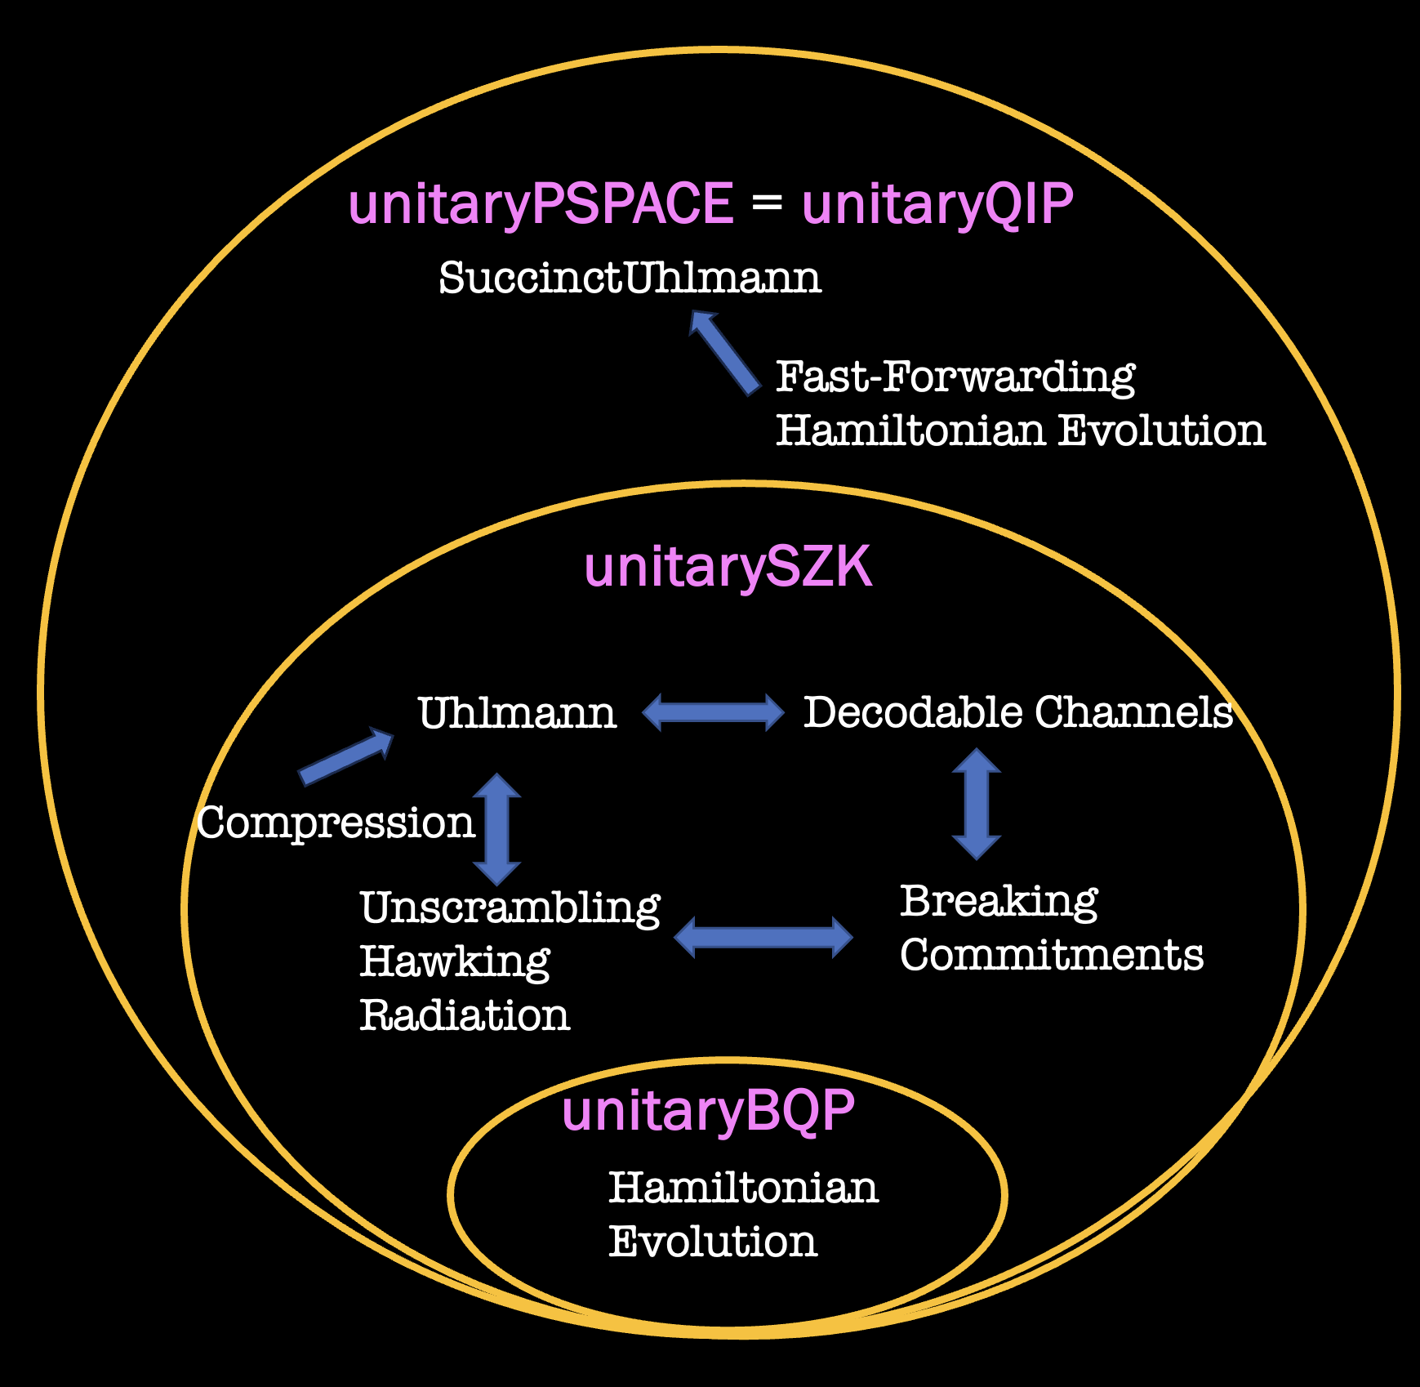
Other future directions
Answer Aaronson, Kuperberg’s Unitary Synthesis Question.
Prove unitary complexity class separations or inclusions that don’t hold (or are not known to hold) in ”decisional” complexity theory.
Develop a complexity-theoretic foundation for quantum cryptography.
Can unitary complexity theory sharpen the use of complexity in high energy physics?
Thank You For Listening!

