Slide 1
MIP* = RE
An overview of
and some of its ingredients
w/ Zhengfeng Ji
Anand Natarajan
Thomas Vidick
John Wright
Henry Yuen
University of Toronto
Notes:
Hi everyone. Thanks for the introduction, and thanks for the invitation to speak. I think it’s really neat that this format is able to allow for a much bigger audience than usual for a department seminar.
So I’m going to give an overview of the MIP* = RE result, which is joint work with Z, A, T, J, and I’ll describe some components of the proof. I won’t assume any particular background in computer science or quantum information theory, but if anything is unclear, please feel free to stop me and ask.

Slide 2
This talk
Correlation sets and Tsirelson’s problem
Computability of nonlocal games
2. Ingredient: Recursive compression of nonlocal games
3. Ingredient: Efficient tests for high dimensional entanglement
Notes:
So this talk is broken down into several parts: first, I’m going to give a brief overview of Tsirelson’s problem, which is about comparing different quantum correlation sets, and how it connects to Connes’ embedding conjecture. If you attended Lewis Bowen’s talk a couple weeks ago this should be a refresher of the last part of his talk. Then I’ll talk about how Tsirelson’s problem connects to a question about the computability of nonlocal games. This first part will explain how answering a computability question has consequences for Tsirelson’s problem and therefore Connes’ embedding problem.
With that in mind I’ll highlight two important components of the proof of MIP* = RE, one being a recursive compression technique for games, which in turn relies on having very efficient tests for high dimensional entanglement.

Slide 3
Correlation Sets, and
Tsirelson’s Problem

Slide 4
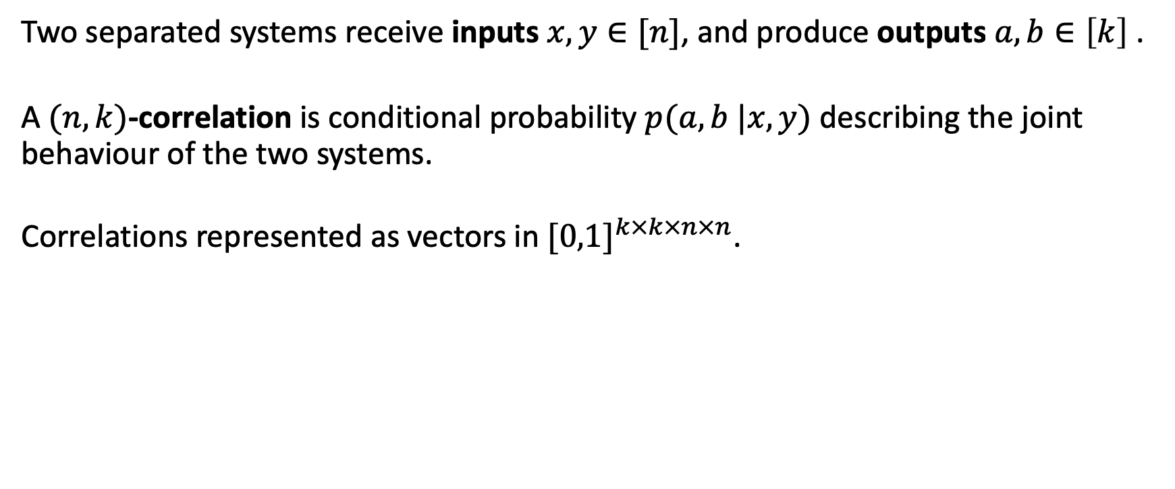




Correlations
Two separated systems receive inputs $x,y∈[n]$, and produce outputs $a,b∈\left[k\right]$ .
A $(n,k)$-correlation is conditional probability $p(a,b |x,y)$ describing the joint behaviour of the two systems.
Correlations represented as vectors in ${[0,1]}^{k×k×n×n}$.
$$x$$
$$y$$
A
B
$$a$$
$$b$$
Notes:
Tsirelson’s problem is about quantum correlations. Well, first what’s a correlation? It’s a mathematical model for the behavior of a physics experiment involving two separated systems, box A and box B. Each box takes in an input (one of n symbols), and produces an output (one of k symbols). Think of the input as telling the box to perform a specific measurement on whatever is inside the box, and the output is the measurement outcome. We can describe the joint input/output behavior of both boxes using a conditional probability p(a,b | x,y) . Correlations can be represented vectors in real space, four tuples of inputs and outputs. In this talk, think of these boxes as being separated far from each other, so they can’t send signals to each other. However, the boxes can be behave non-independently, and question is what correlations are allowed by physics. Well, it depends on your model of physics.

Slide 5

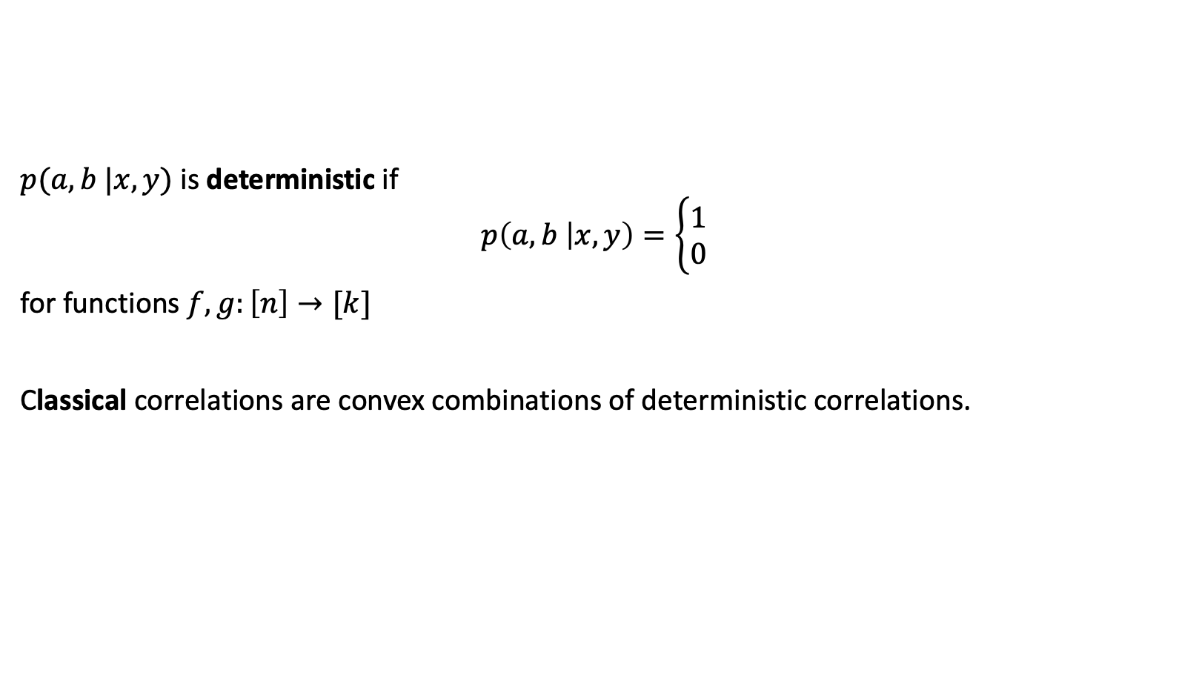



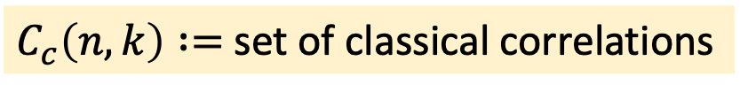

Classical correlations
$$x$$
$$y$$
A
B
$$f(x)$$
$$g(y)$$
$p(a,b |x,y)$ is deterministic if
$$p\left(a,b | x,y\right)=\left\{\begin{aligned}1 \\ 0\end{aligned}\right.$$
for functions $f,g:\left[n\right]→[k]$
Classical correlations are convex combinations of deterministic correlations.
if $a=f\left(x\right), b=g(y)$
otherwise
Models correlations described by classical physics
$C_{c}\left(n,k\right) :=$ set of classical correlations
Notes:
If your model of physics is classical, then you get the set of classical correlations. These are built out of deterministic correlations. Here, the outputs of each box is a deterministic function of their inputs. You’re also allowed to take convex combinations of deterministic correlations. Let C_c(n,k) denote the set of classical correlations, where we treat the correlations as vectors in real space.

Slide 6


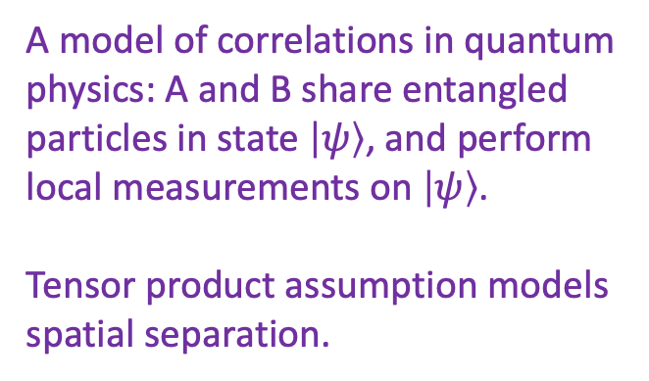
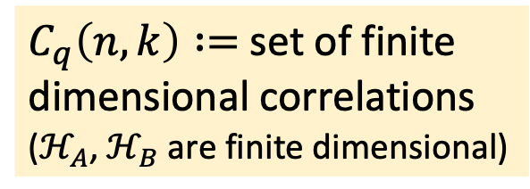
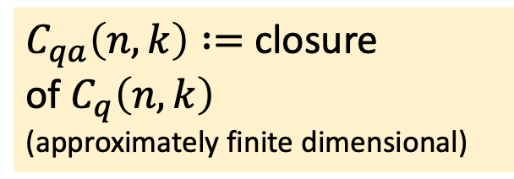
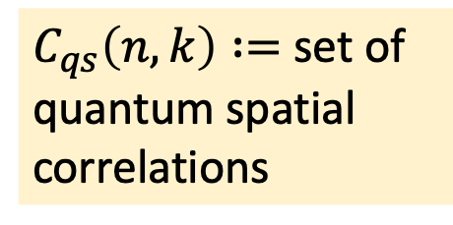

Quantum correlations
$$x$$
$$y$$
A
B
$$a$$
$$b$$
$p(a,b |x,y)$ is quantum spatial if $p\left(a,b | x,y\right)=⟨ψ, A_{x,a}^{}⊗B_{y,b}^{} ψ⟩$ where
Hilbert space $ℋ_{A}$, $ℋ_{B}$(could be infinite dimensional)
Unit vector $\left|ψ\right\rangle ∈ℋ_{A}⊗ℋ_{B}$
POVMs ${\left\{A_{x,a}^{}\right\}}_{a}$ acting on $ℋ_{A}$, ${\left\{B_{y,b}^{}\right\}}_{b}$ acting on $ℋ_{B}$
  POVMs are positive operators that sum to identity
  (when summed over output set)
A model of correlations in quantum physics: A and B share entangled particles in state $\left|ψ\right\rangle$, and perform local measurements on $\left|ψ\right\rangle$.
Tensor product assumption models spatial separation.
$C_{q}\left(n,k\right) :=$ set of finite dimensional correlations
($ℋ_{A}$, $ℋ_{B}$ are finite dimensional)
$C_{qs}\left(n,k\right) :=$ set of quantum spatial correlations
$C_{qa}\left(n,k\right) :=$ closure
of $C_{q}\left(n,k\right)$
(approximately finite dimensional)
⊆
⊆
Notes:
Well, we believe that nature is not described by classical physics but rather by quantum physics, and there the set of correlations appear to get richer, they arise from something called quantum entanglement. Here, one way of modeling quantum correlations is to associate with each box a Hilbert space, possibly infinite dimensional. The joint state of the boxes is described by unit vector psi in tensor product of the two Hilbert spaces. When box A gets an input x, it performs a measurement on its part of the state to obtain some outcome a. For each input, the measurement is described by a set of positive operators, indexed by outcomes, summing to the identity. The probability of getting output pair (a,b) given inputs (x,y) is given by this expectation value, which depends on the tensor product of the A and B operators. This tensor product assumption is a natural way to model spatial separation. If we think of the two boxes as representing two independent physics labs, then it’s natural to say that each lab has its own Hilbert space to model what’s going on inside of it.

Slide 7

Quantum correlations II
$$x$$
$$y$$
A
B
$$a$$
$$b$$
$p(a,b |x,y)$ is quantum commuting if $p\left(a,b | x,y\right)=⟨ψ,A_{x,a}^{}⋅B_{y,b}^{} ψ⟩$ where
Hilbert space $ℋ$
Unit vector $\left|ψ\right\rangle ∈ℋ$
POVMs ${\left\{A_{x,a}^{}\right\}}_{a}$ , ${\left\{B_{y,b}^{}\right\}}_{b}$ acting on $ℋ$
where $\left[A_{x,a}^{},B_{y,b}^{}\right]=0$ for all $x,y,a,b$.
A more general model of correlations in quantum physics, motivated by QFTs.
There is only one Hilbert space, but A and B measurements commute (outcomes are causally independent).
Tensor product structure not a priori present in general QFTs.
$C_{qc}\left(n,k\right) :=$ set of quantum commuting correlations
Notes:
There’s a more general way of modeling quantum correlations, called the commuting operator model. Here, there is only one Hilbert space H, and the measurement operators of each box act on the same Hilbert space. However the measurement operators of box A and box B commute with each other. This model captures the tensor product model, but may include more types of correlations. It’s motivated by the study of QFTs, in which given separated two systems, it’s not a priori clear how to decompose their state space into a tensor product of two Hilbert spaces. However the commutation condition captures the notion that the order of measurements don’t matter.

Slide 8
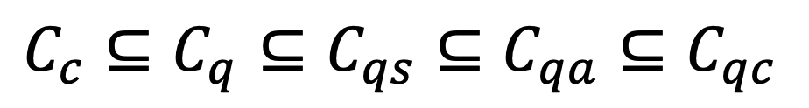
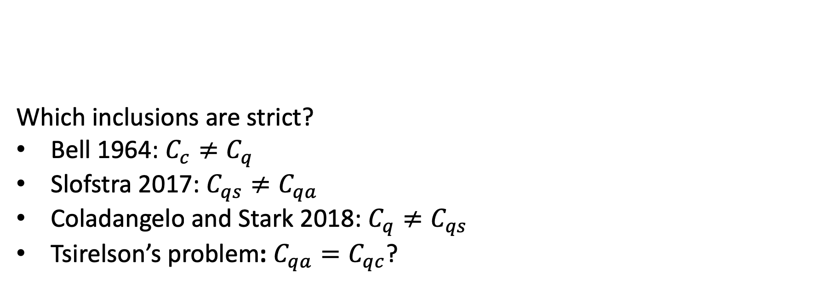
Approx finite dim
Commuting operator
Classical
Finite dim
Spatial
Which inclusions are strict?
Bell 1964: $C_{c}≠C_{q}$
Slofstra 2017: $C_{qs}≠C_{qa}$
Coladangelo and Stark 2018: $C_{q}≠C_{qs}$
Tsirelson’s problem: $C_{qa}=C_{qc}$?
$$C_{c}⊆C_{q}⊆C_{qs}⊆C_{qa}⊆C_{qc}$$
Classical ≠ Quantum
Spatial correlations are not closed
Finite dimensions ≠ Infinite dimensions
Commuting correlations approximable by
finite dimensional correlations?

Slide 9
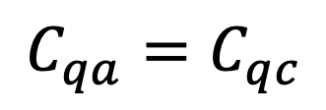
From Tsirelson to Connes
[Fritz 2010]
[Junge-Navascues-Palazuelos-Perez Garcia-Scholz-Werner 2010]
Kirchberg’s QWEP
Conjecture
Connes’ Embedding
Conjecture
$$C_{qa}=C_{qc}$$
[Kirchberg 1993]
[Ozawa 2013]

Slide 10
Nonlocal games

Slide 11



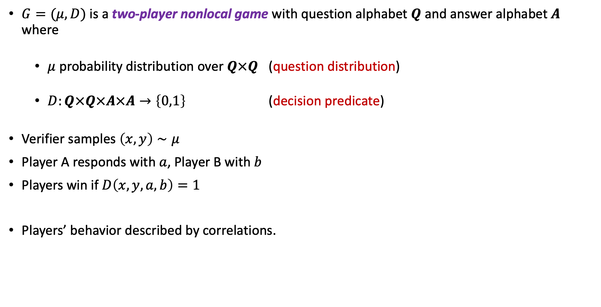



Nonlocal games
$G=(μ, D)$ is a two-player nonlocal game with question alphabet $Q$ and answer alphabet $A$ where
  $μ$ probability distribution over $Q×Q$ (question distribution)
  $D:Q×Q×A×A→\left\{0,1\right\}$ (decision predicate)
Verifier samples $\left(x,y\right)∼μ$
Player A responds with $a$, Player B with $b$
Players win if $D\left(x,y,a,b\right)=1$
Players’ behavior described by correlations.
$$μ$$
$$x$$
$$y$$
A
B
$$a$$
$$b$$
$$D$$

Slide 12
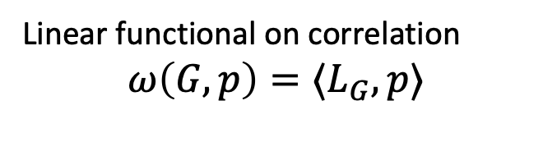
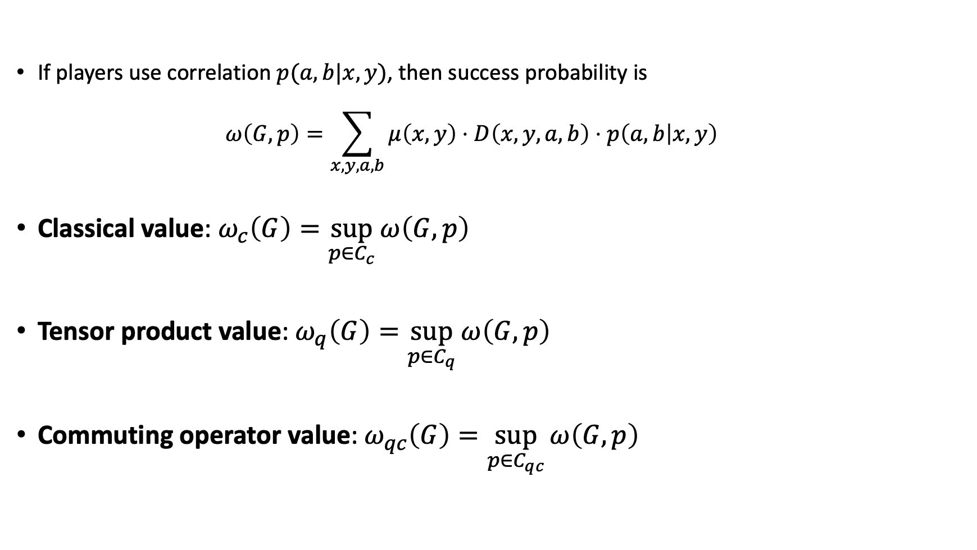

Measuring success
Linear functional on correlation
$$ω\left(G,p\right)=⟨L_{G},p⟩$$
If players use correlation $p(a,b|x,y)$, then success probability is
  $$ω\left(G,p\right)=\sum_{x,y,a,b}{μ\left(x,y\right)⋅D\left(x,y,a,b\right)⋅p\left(a,b | x,y\right)}$$
Classical value: $ω_{c}\left(G\right)=\sup_{p∈C_{c}}{ω\left(G,p\right)}$
Tensor product value: $ω_{q}\left(G\right)=\sup_{p∈C_{q}}{ω\left(G,p\right)}$
Commuting operator value: $ω_{qc}\left(G\right)=\sup_{p∈C_{qc}}{ω\left(G,p\right)}$
  Same as optimizing over $C_{qs},C_{qa}$

Slide 13
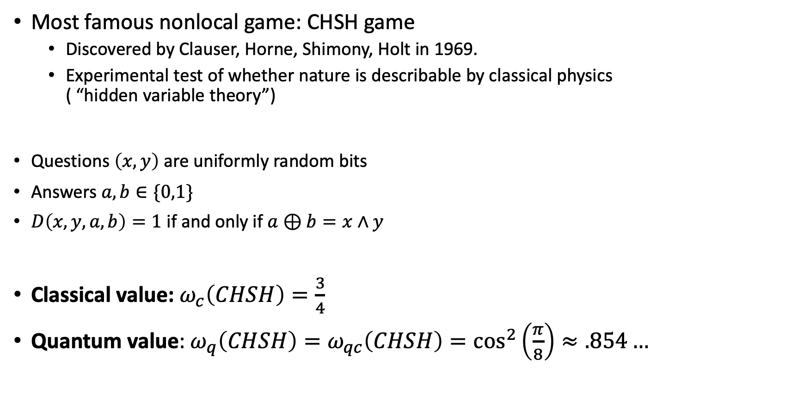
Example: CHSH game
Most famous nonlocal game: CHSH game
  Discovered by Clauser, Horne, Shimony, Holt in 1969.
  Experimental test of whether nature is describable by classical physics
  ( “hidden variable theory”)
Questions $\left(x,y\right)$ are uniformly random bits
Answers $a,b∈\{0,1\}$
$D\left(x,y,a,b\right)=1$ if and only if $a⊕b=x∧y$
Classical value: $ω_{c}\left(CHSH\right)=\frac{3}{4}$
Quantum value: $ω_{q}\left(CHSH\right)=ω_{qc}\left(CHSH\right)=\cos^{2}\left(\frac{π}{8}\right)≈.854…$
Experimentally tested!

Slide 14
Computability of nonlocal games

Slide 15



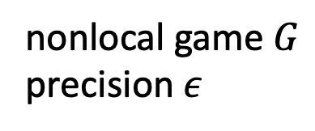
In 2004, Cleve, Hoyer, Toner and Watrous, computer scientists studying the interplay between complexity theory and quantum information, asked the following question:
Is there an algorithm to approximate $ω_{q}\left(G\right)$?
nonlocal game $G$
precision $ε$
If so, what is the fastest algorithm?
If you can approximate $ω_{q}$, what other problems can you solve?
Can approximating $ω_{q}$ be reduced to solving some other problem?
$$ω_{q}\left(G\right)±ε$$

Slide 16
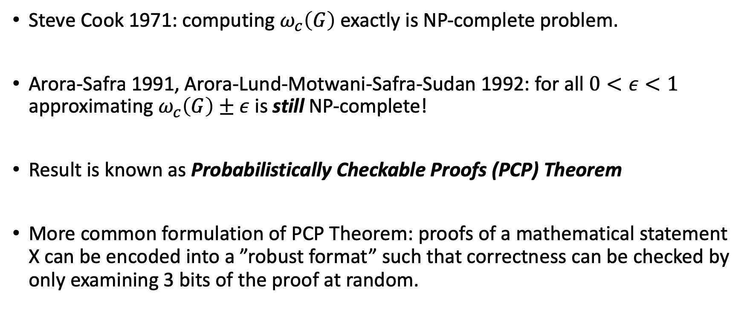
Motivation from classical theoretical computer science
Steve Cook 1971: computing $ω_{c}\left(G\right)$ exactly is NP-complete problem.
Arora-Safra 1991, Arora-Lund-Motwani-Safra-Sudan 1992: for all $0<ε<1$ approximating $ω_{c}\left(G\right)±ε$ is still NP-complete!
Result is known as Probabilistically Checkable Proofs (PCP) Theorem
More common formulation of PCP Theorem: proofs of a mathematical statement X can be encoded into a ”robust format” such that correctness can be checked by only examining 3 bits of the proof at random.

Slide 17
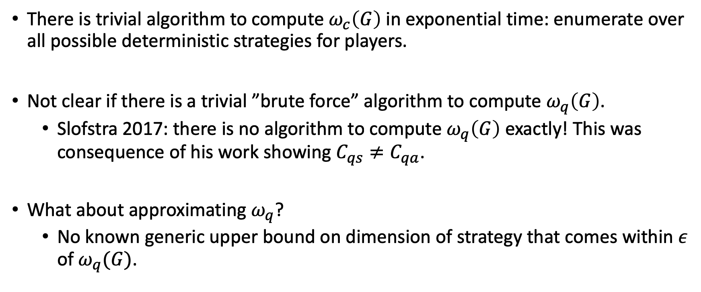

Barriers to an algorithm for $ω_{q}$
There is trivial algorithm to compute $ω_{c}\left(G\right)$ in exponential time: enumerate over all possible deterministic strategies for players.
Not clear if there is a trivial ”brute force” algorithm to compute $ω_{q}\left(G\right)$.
  Slofstra 2017: there is no algorithm to compute $ω_{q}\left(G\right)$ exactly! This was consequence of his work showing $C_{qs}≠C_{qa}$.
What about approximating $ω_{q}$?
  No known generic upper bound on dimension of strategy that comes within $ε$ of $ω_{q}(G)$.

Slide 18
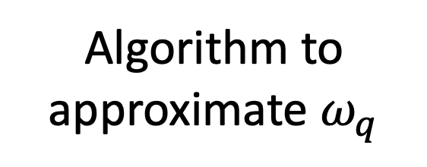
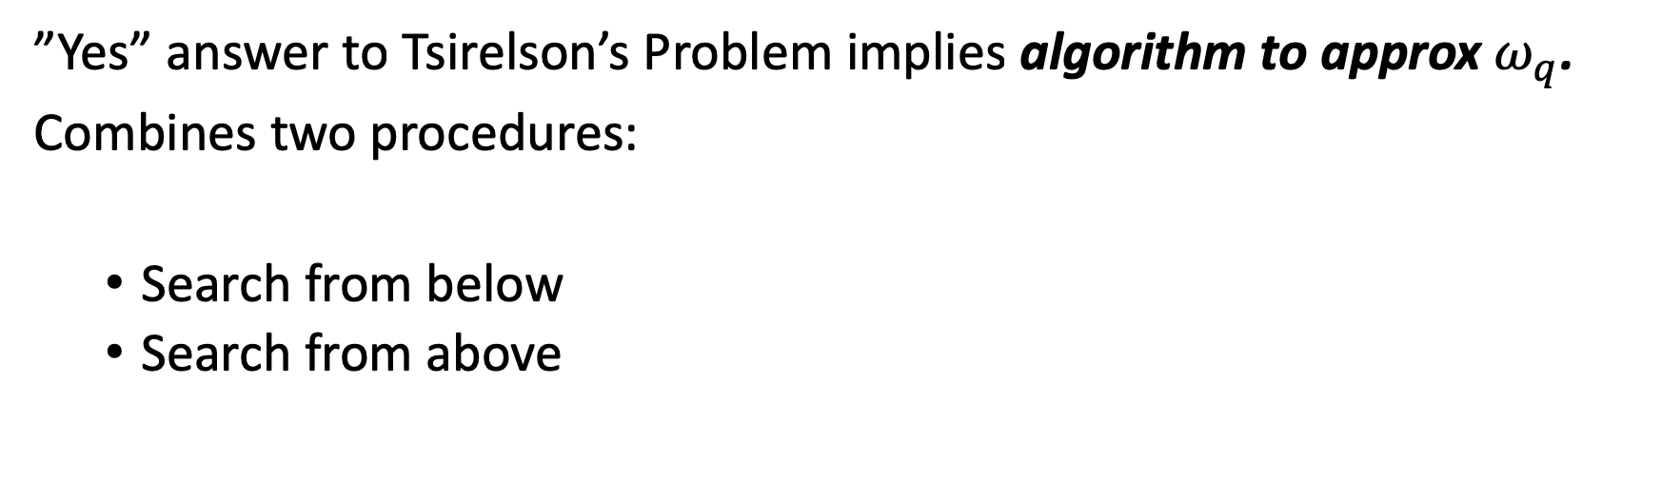
Connes’ embedding problem
Tsirelson’s
problem
Algorithm to
approximate $ω_{q}$
”Yes” answer to Tsirelson’s Problem implies algorithm to approx $ω_{q}$.
Combines two procedures:
  Search from below
  Search from above

Slide 19

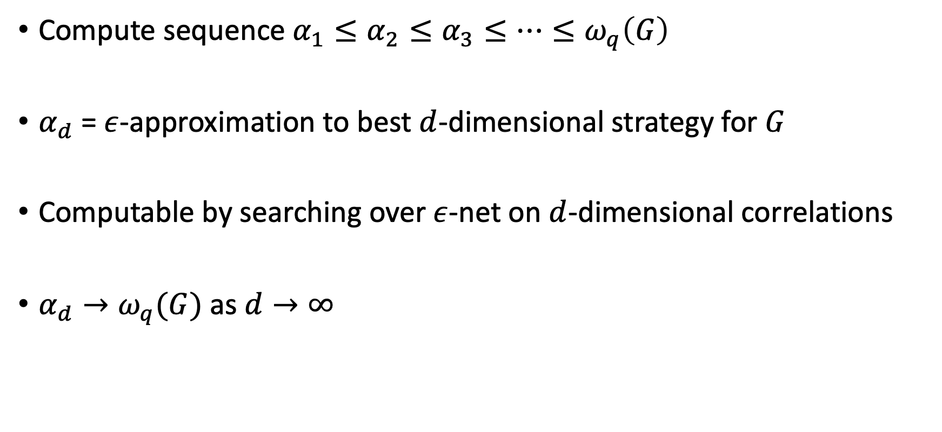
Search from below
Value
$$ω_{q}\left(G\right)$$
Compute sequence $α_{1}≤α_{2}≤α_{3}≤⋯≤ω_{q}\left(G\right)$
$α_{d}$ = $ε$-approximation to best $d$-dimensional strategy for $G$
Computable by searching over $ε$-net on $d$-dimensional correlations
$α_{d}→ω_{q}(G)$ as $d→∞$
Time

Slide 20

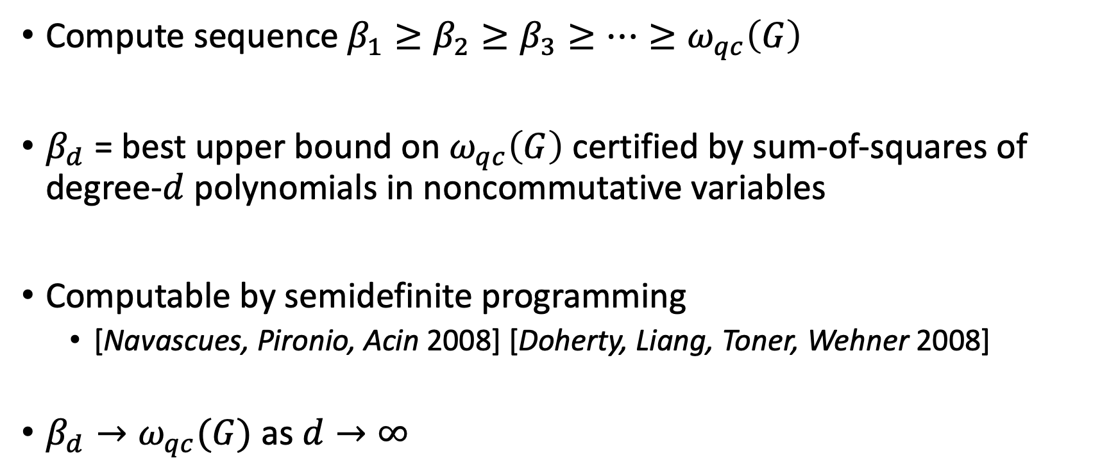
Search from above
Value
$$ω_{qc}\left(G\right)$$
Compute sequence $β_{1}≥β_{2}≥β_{3}≥⋯≥ω_{qc}\left(G\right)$
$β_{d}$ = best upper bound on $ω_{qc}\left(G\right)$ certified by sum-of-squares of degree-$d$ polynomials in noncommutative variables
Computable by semidefinite programming
  [Navascues, Pironio, Acin 2008] [Doherty, Liang, Toner, Wehner 2008]
$β_{d}→ω_{qc}(G)$ as $d→∞$
Time

Slide 21
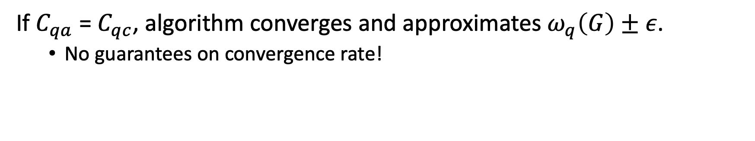

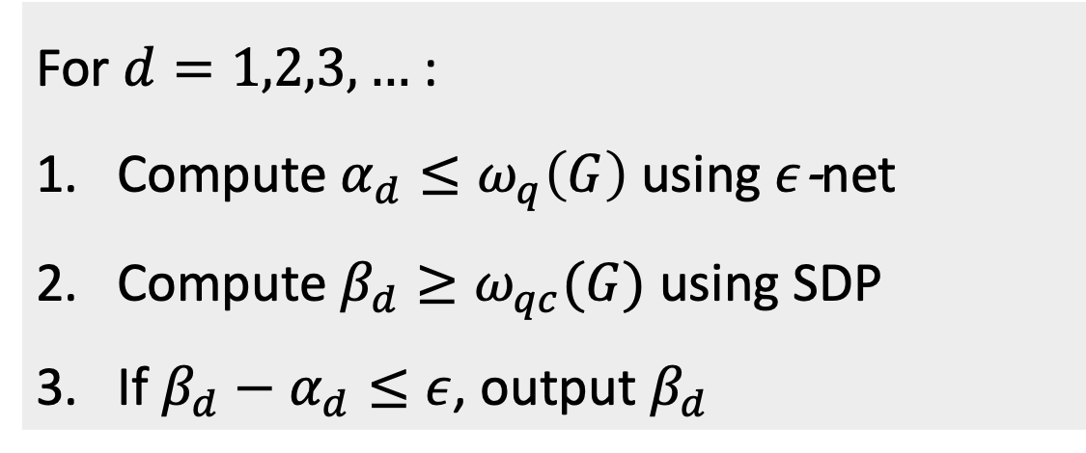
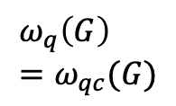
Algorithm to approximate $ω_{q}$, assuming Tsirelson
For $d=1,2,3,…$:
Compute $α_{d}≤ω_{q}\left(G\right)$ using $ε$-net
Compute $β_{d}≥ω_{qc}(G)$ using SDP
If $β_{d}−α_{d}≤ε$, output $β_{d}$
Value
$$ω_{q}\left(G\right) \\ =ω_{qc}(G)$$
Time
If $C_{qa}$ = $C_{qc}$, algorithm converges and approximates $ω_{q}\left(G\right)±ε$.
  No guarantees on convergence rate!

Slide 22
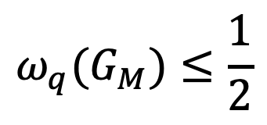

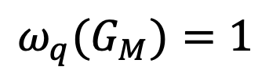
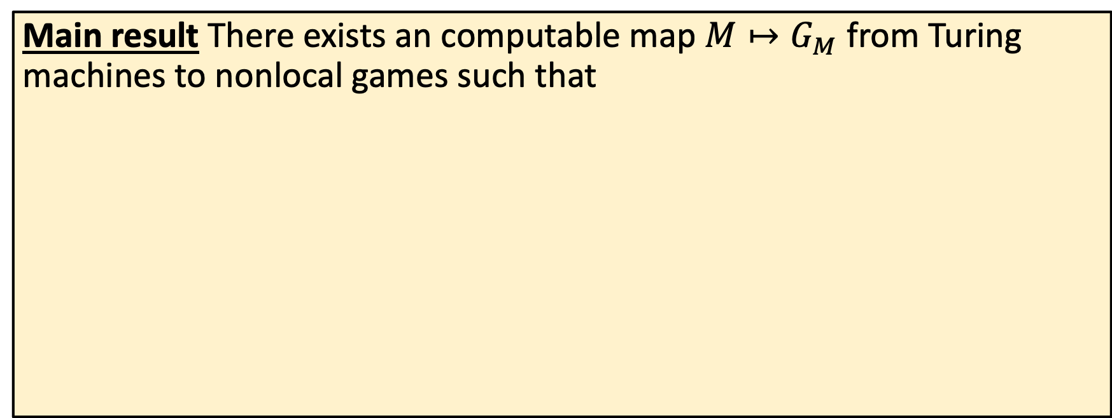



MIP* = RE
Main result There exists an computable map $M↦G_{M}$ from Turing machines to nonlocal games such that
$${ω_{q}(G}_{M})=1$$
$M$ halts
Turing machine
$$M$$
$$G_{M}$$
$${ω_{q}(G}_{M})≤\frac{1}{2}$$
½ can be replaced by any constant less than 1.
$M$ does not halt

Slide 23
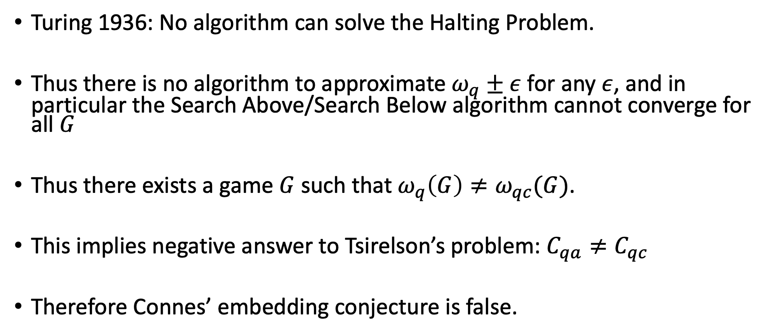
Implications
Turing 1936: No algorithm can solve the Halting Problem.
Thus there is no algorithm to approximate $ω_{q}±ε$ for any $ε$, and in particular the Search Above/Search Below algorithm cannot converge for all $G$
Thus there exists a game $G$ such that $ω_{q}\left(G\right)≠ω_{qc}(G)$.
This implies negative answer to Tsirelson’s problem: $C_{qa}≠C_{qc}$
Therefore Connes’ embedding conjecture is false.

Slide 24
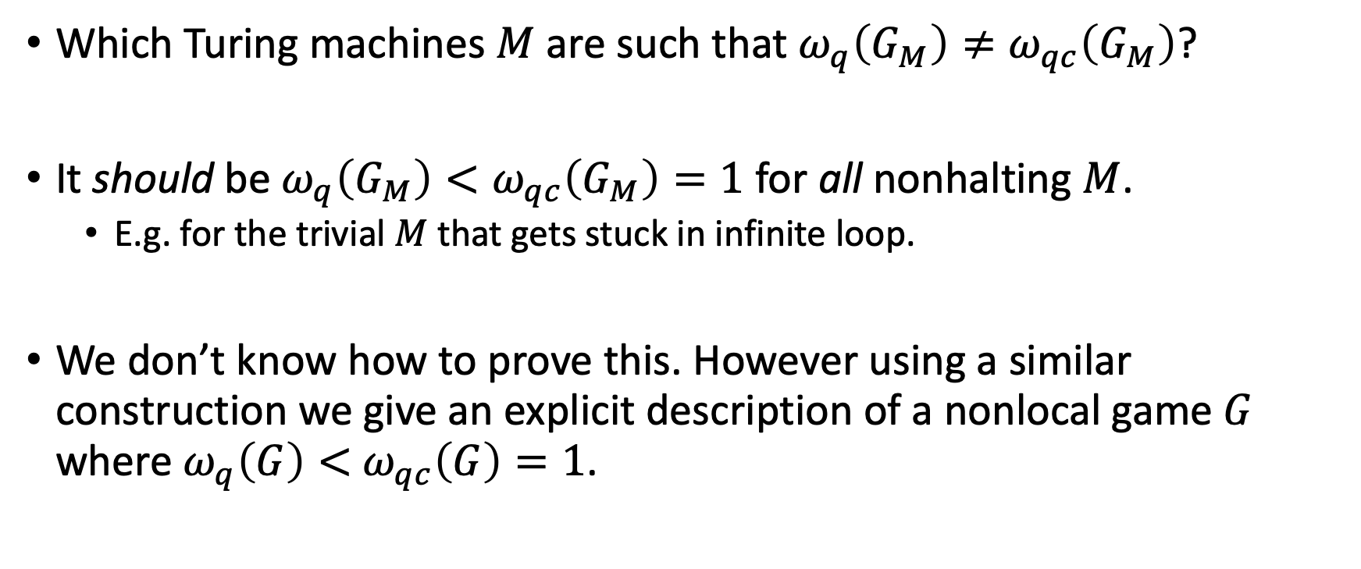
An explicit counter-example?
Which Turing machines $M$ are such that $ω_{q}\left(G_{M}\right)≠ω_{qc}\left(G_{M}\right)$?
It should be $ω_{q}\left(G_{M}\right)<ω_{qc}\left(G_{M}\right)=1$ for all nonhalting $M$.
  E.g. for the trivial $M$ that gets stuck in infinite loop.
We don’t know how to prove this. However using a similar construction we give an explicit description of a nonlocal game $G$ where $ω_{q}\left(G\right)<$ $ω_{qc}\left(G\right)=1$.

Slide 25
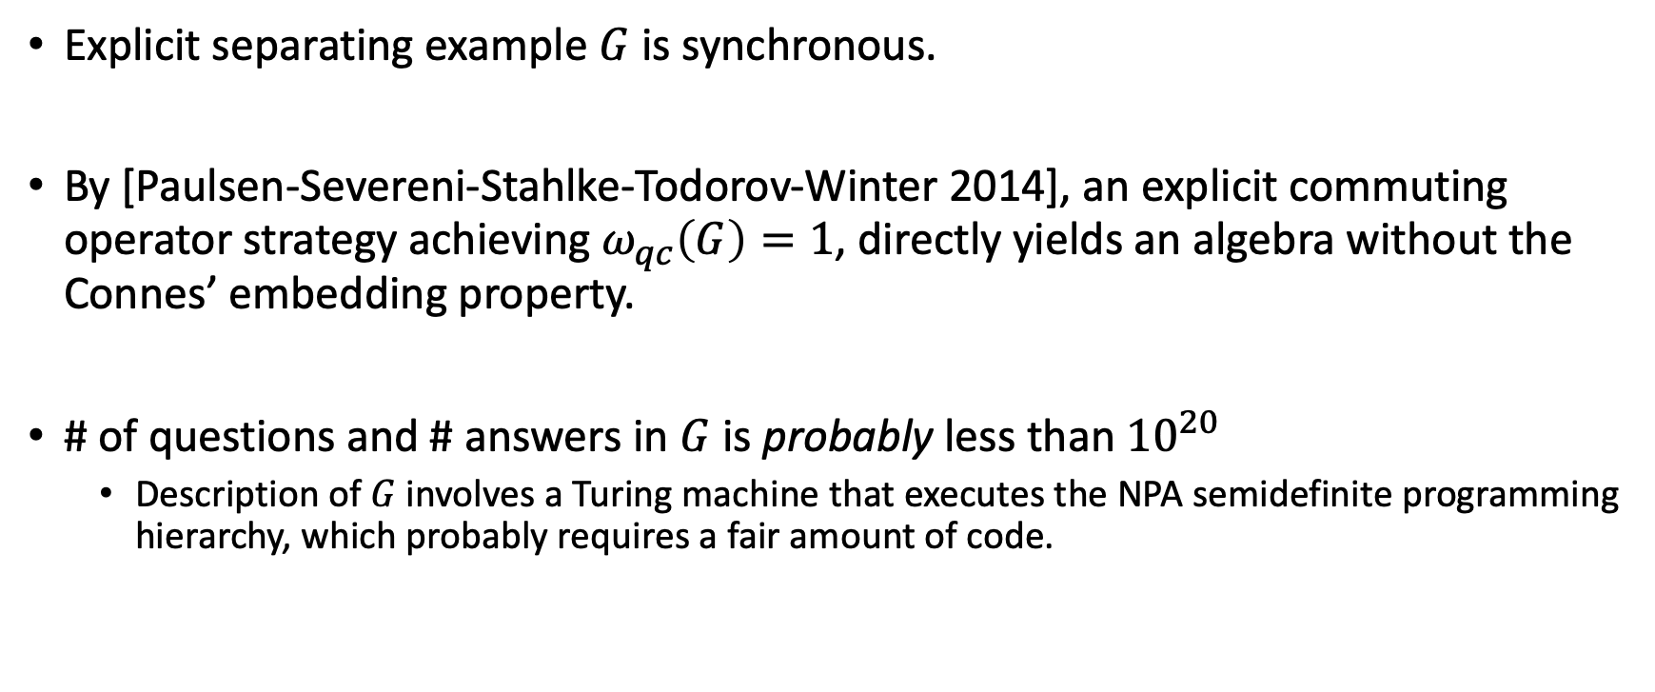
An explicit counter-example?
Explicit separating example $G$ is synchronous.
By [Paulsen-Severeni-Stahlke-Todorov-Winter 2014], an explicit commuting operator strategy achieving $ω_{qc}\left(G\right)=1$, directly yields an algebra without the Connes’ embedding property.
# of questions and # answers in $G$ is probably less than ${10}^{20}$
  Description of $G$ involves a Turing machine that executes the NPA semidefinite programming hierarchy, which probably requires a fair amount of code.

Slide 26
Ingredient #1:
Recursive compression of nonlocal games

Slide 27
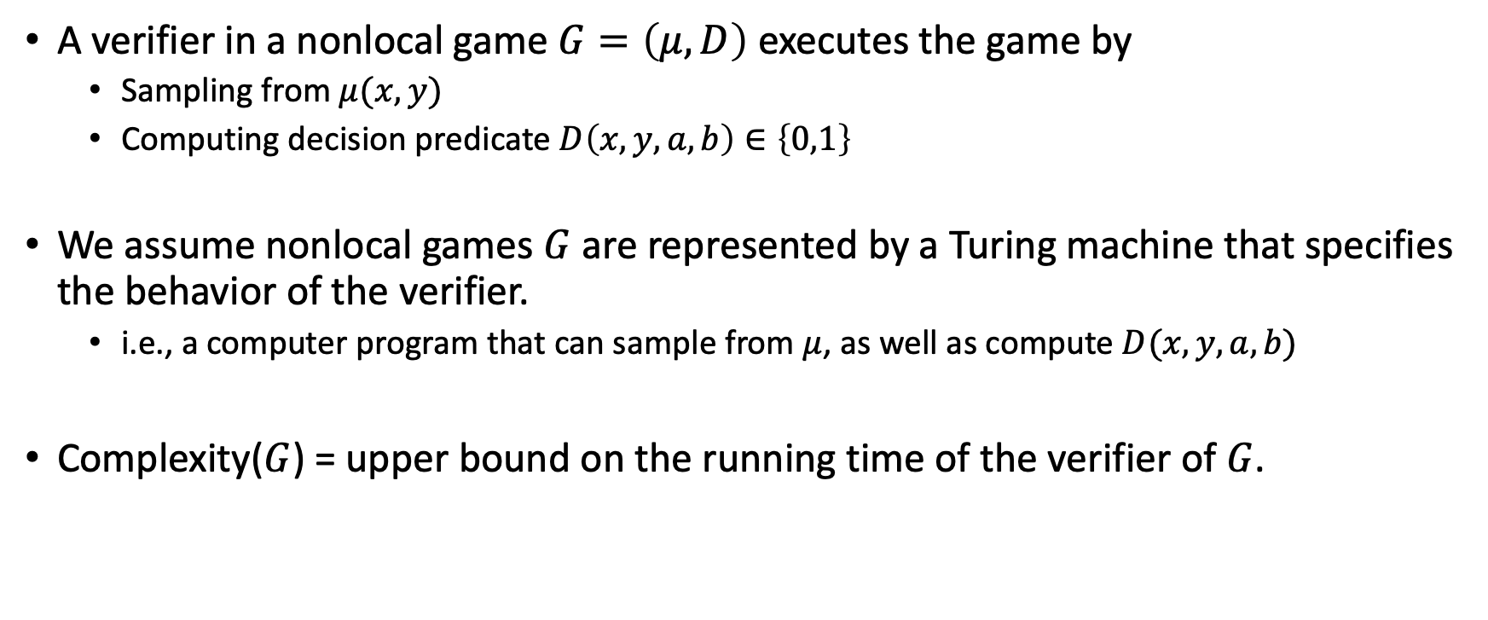
Turing machine representation of nonlocal games
A verifier in a nonlocal game $G=\left(μ,D\right)$ executes the game by
  Sampling from $μ(x,y)$
  Computing decision predicate $D\left(x,y,a,b\right)∈\left\{0,1\right\}$
We assume nonlocal games $G$ are represented by a Turing machine that specifies the behavior of the verifier.
  i.e., a computer program that can sample from $μ$, as well as compute $D(x,y,a,b)$
Complexity($G$) = upper bound on the running time of the verifier of $G$.

Slide 28
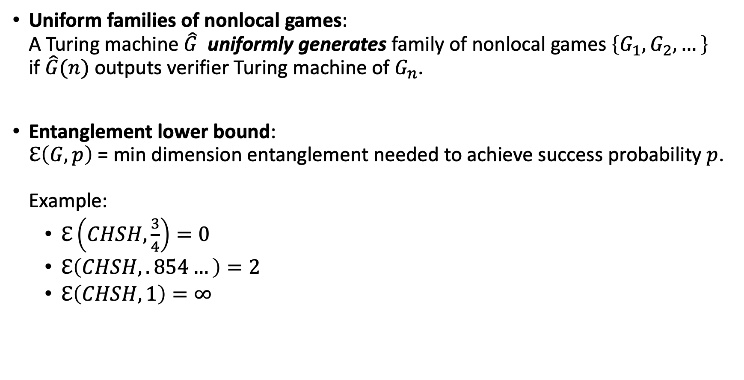
Some notation
Uniform families of nonlocal games:
A Turing machine $\hat{G}$ uniformly generates family of nonlocal games $\left\{G_{1},G_{2},…\right\}$
if $\hat{G}(n)$ outputs verifier Turing machine of $G_{n}$.
Entanglement lower bound:
$ℇ\left(G,p\right)$ = min dimension entanglement needed to achieve success probability $p$.
Example:
  $ℇ\left(CHSH,\frac{3}{4}\right)=0$
  $ℇ\left(CHSH,.854…\right)=2$
  $ℇ\left(CHSH,1\right)=∞$

Slide 29
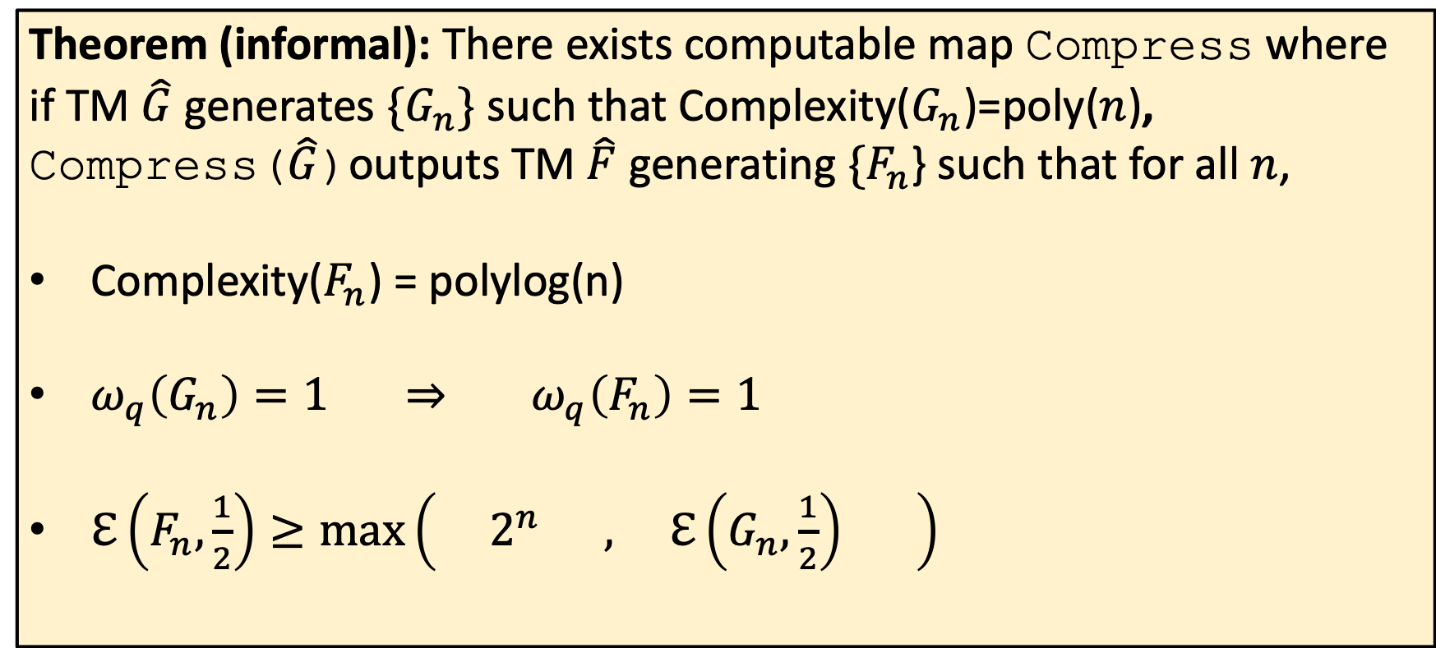
The Compression theorem
Theorem (informal): There exists computable map Compress where if TM $\hat{G}$ generates $\{G_{n}\}$ such that Complexity($G_{n}$)=poly($n$), Compress($\hat{G}$)outputs TM $\hat{F}$ generating $\{F_{n}$} such that for all $n$,
Complexity($F_{n}$) = polylog(n)
$ω_{q}\left(G_{n}\right)=1 ⇒$ $ω_{q}\left(F_{n}\right)=1$
$ℇ\left(F_{n},\frac{1}{2}\right)≥\max\left( 2^{n} , ℇ\left(G_{n},\frac{1}{2}\right) \right)$
Complexity reduction
Completeness preserving
Dimension lower bound

Slide 30

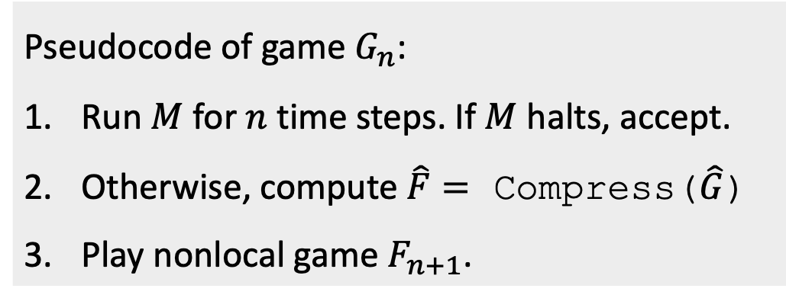
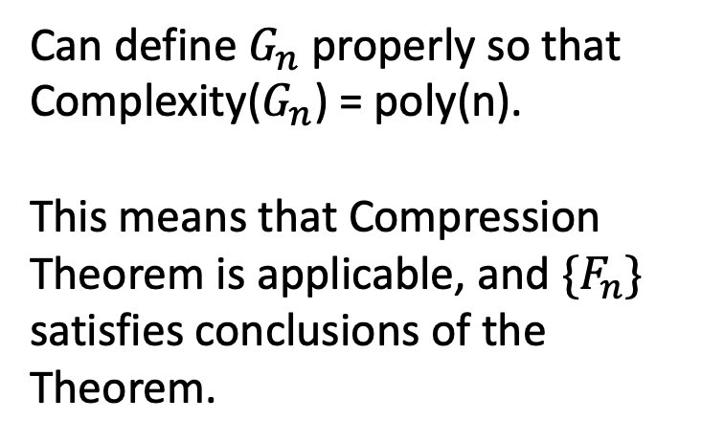
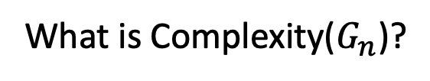
Recursive compression
What is Complexity($G_{n}$)?
Fix Turing machine $M$. Define $\hat{G}=\{G_{n}\}$:
Pseudocode of game $G_{n}$:
Run $M$ for $n$ time steps. If $M$ halts, accept.
Otherwise, compute $\hat{F}=$ Compress($\hat{G}$)
Play nonlocal game $F_{n+1}$.
Can define $G_{n}$ properly so that Complexity($G_{n}$) = poly(n).
This means that Compression Theorem is applicable, and$\{F_{n}\}$ satisfies conclusions of the Theorem.

Slide 31

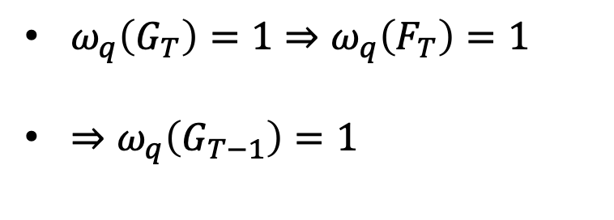
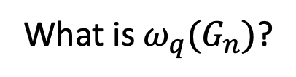
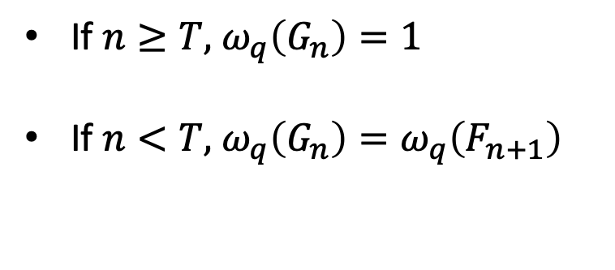
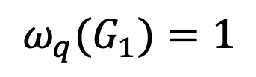
Recursive compression
What is ${ω_{q}(G}_{n})$?
Case 1: $M$ halts in time $T$.
Fix Turing machine $M$. Define $\hat{G}=\{G_{n}\}$:
If $n≥T,$ $ω_{q}\left(G_{n}\right)=1$
If $n<T,$ $ω_{q}\left(G_{n}\right)=ω_{q}\left(F_{n+1}\right)$
Pseudocode of game $G_{n}$:
Run $M$ for $n$ time steps. If $M$ halts, accept.
Otherwise, compute $\hat{F}=$ Compress($\hat{G}$)
Play nonlocal game $F_{n+1}$.
By Compression Theorem
$ω_{q}\left(G_{T}\right)=1⇒ω_{q}\left(F_{T}\right)=1$
$⇒ω_{q}\left(G_{T−1}\right)=1$
$${ω_{q}(G}_{1})=1$$
Rinse, repeat
… $⇒ω_{q}\left(G_{1}\right)=1$

Slide 32

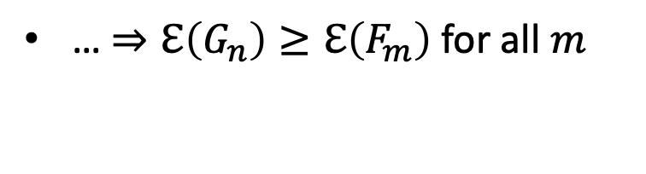

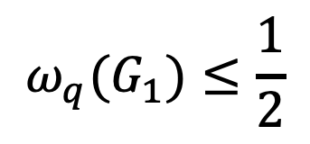
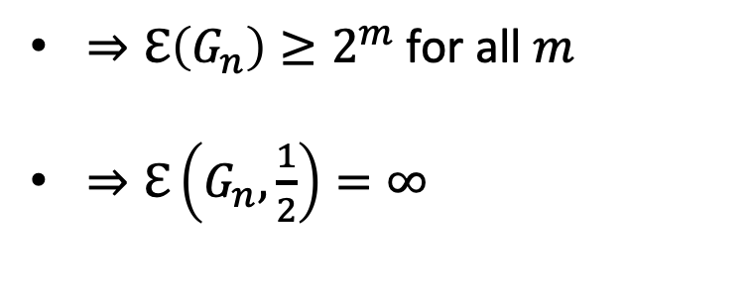
Recursive compression
What is ${ω_{q}(G}_{n})$?
Case 2: $M$ never halts.
Fix Turing machine $M$. Define $\hat{G}=\{G_{n}\}$:
For all $n$, $ℇ\left(G_{n},\frac{1}{2}\right)=ℇ\left(F_{n+1},\frac{1}{2}\right)$
Pseudocode of game $G_{n}$:
Run $M$ for $n$ time steps. If $M$ halts, accept.
Otherwise, compute $\hat{F}=$ Compress($\hat{G}$)
Play nonlocal game $F_{n+1}$.
By Dimension Lower Bound
$⇒ ℇ\left(F_{n+1} \right)≥ℇ\left(G_{n+1}\right)$
Rinse, repeat
… $⇒ℇ\left(G_{n}\right)≥ℇ\left(F_{m}\right)$ for all $m$
By Dimension Lower Bound
$${ω_{q}(G}_{1})≤\frac{1}{2}$$
$⇒ℇ\left(G_{n}\right)≥2^{m}$ for all $m$
$⇒ℇ\left(G_{n},\frac{1}{2}\right)=∞$

Slide 33
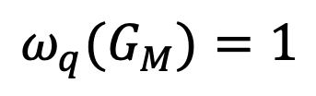



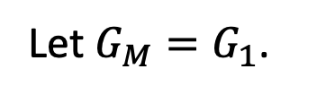


Recursive compression
Fix Turing machine $M$. Define $\hat{G}=\{G_{n}\}$:
Pseudocode of game $G_{n}$:
Run $M$ for $n$ time steps. If $M$ halts, accept.
Otherwise, compute $\hat{F}=$ Compress($\hat{G}$)
Play nonlocal game $F_{n+1}$.
$${ω_{q}(G}_{M})=1$$
$M$ halts
Let $G_{M}=G_{1}$.
$$M$$
$$G_{M}$$
$${ω_{q}(G}_{M})≤\frac{1}{2}$$
$M$ does not halt

Slide 34
Ingredient #2:
Efficient tests for
high dimensional entanglement

Slide 35
The Compression theorem
Theorem (informal): There exists computable map Compress where if TM $\hat{G}$ generates $\{G_{n}\}$ such that Complexity($G_{n}$)=poly($n$), Compress($\hat{G}$)outputs TM $\hat{F}$ generating $\{F_{n}$} such that for all $n$,
Complexity($F_{n}$) = polylog(n)
$ω_{q}\left(G_{n}\right)=1 ⇒$ $ω_{q}\left(F_{n}\right)=1$
$ℇ\left(F_{n},\frac{1}{2}\right)≥\max\left( 2^{n} , ℇ\left(G_{n},\frac{1}{2}\right) \right)$
Complexity reduction
Completeness preserving
Dimension lower bound

Slide 36

The CHSH game
$D\left(x,y,a,b\right)=1$ if and only if $a⊕b=x∧y$
$ω_{c}\left(CHSH\right)=\frac{3}{4}$
$ω_{q}\left(CHSH\right)=.854…$
Observing a winning probability greater than 75% indicates presence of entanglement
CHSH game guarantees more: it has a rigidity property.

Slide 37

CHSH game rigidity
Textbook quantum strategy for CHSH:
  Correlation: $p\left(a,b | x,y\right)=⟨ψ, A_{x,a}^{}⊗B_{y,b}^{} ψ⟩$
  State $\left|ψ\right\rangle =\frac{1}{\sqrt{2}}\left(\left|00\right\rangle +|11⟩\right)∈ℂ^{2}⊗ℂ^{2}$
  Measurement operators:
  $A_{0}=A_{0,0}−A_{0,1}=\left(\begin{matrix}1 & 0 \\ 0 & −1\end{matrix}\right)=σ_{Z}$
  $A_{1}=A_{1,0}−A_{1,1}=\left(\begin{matrix}0 & 1 \\ 1 & 0\end{matrix}\right)=σ_{X}$
  $B_{0}=\frac{1}{\sqrt{2}}(σ_{Z}+σ_{X})$
  $B_{0}=\frac{1}{\sqrt{2}}(σ_{Z}−σ_{X})$

Slide 38

CHSH game rigidity
Suppose : $p\left(a,b | x,y\right)=\left\langle ψ, A_{x,a}^{}⊗B_{y,b}^{} ψ\right\rangle$ achieves optimal winning probability $ω_{q}\left(CHSH\right).$
This forces certain anti-commutation relations:
  $A_{0}A_{1}\left|ψ\right\rangle =−A_{1}A_{0}\left|ψ\right\rangle$
  $B_{0}B\left|ψ\right\rangle =−B_{1}B_{0}|ψ⟩$
Furthermore, there exist local isometries, under which
$A_{0}≡σ_{Z}$ $A_{1}≡σ_{X}$
$\left|ψ\right\rangle ≡\frac{1}{2}\left(\left|00\right\rangle +|11⟩\right)$
Textbook strategy for CHSH is unique optimal solution (up to local isometries)!

Slide 39

CHSH game rigidity
Suppose : $p\left(a,b | x,y\right)=\left\langle ψ, A_{x,a}^{}⊗B_{y,b}^{} ψ\right\rangle$ achieves approximately optimal winning probability $ω_{q}\left(CHSH\right)−ε.$
This forces certain approximate anti-commutation relations:
  $A_{0}A_{1}\left|ψ\right\rangle ≈_{\sqrt{ε}}−A_{1}A_{0}\left|ψ\right\rangle$
  $B_{0}B\left|ψ\right\rangle ≈_{\sqrt{ε}}−B_{1}B_{0}|ψ⟩$
Furthermore, there exist approximate local isometries, under which
$A_{0}≅_{√ε}σ_{Z}$ $A_{1}≅_{√ε}σ_{X}$
$\left|ψ\right\rangle ≅_{√ε}\frac{1}{2}\left(\left|00\right\rangle +|11⟩\right)$
Rigidity phenomenon is robust!

Slide 40

Testing quantum behavior
CHSH game tests for anticommuting measurements.
What about testing higher dimensional strategies?
Idea: play $n$ instances of CHSH in parallel, and check that players win all of the instances.
  Optimal strategy requires strategy of dimension $2^{n}$.
Undesirable aspects of parallel repeated CHSH game:
  Max success probability goes down exponentially with $n$
  Complexity of game scales linearly with $n$

Slide 41

Testing for high dimensional entanglement
Quantum Low-Degree Test (Natarajan-Vidick 2018): There exists a family of games $\{Q_{n}\}$ such that for all $n$,
Complexity($Q_{n}$) = polylog(n)
$ω_{q}\left(Q\right)=1$
$ℇ\left(Q_{n},1−ε\right)≥{\left(1 −{O(ε}^{c})\right)⋅2}^{n}$

Slide 42

Quantum Low-Degree Test
Algebraic statement: For all strategies that pass $Q_{n}$with probability $1−ε$, the algebra generated by the measurement operators of a player must be $O(ε^{c})$-approximate representation of the algebra of the $n$-fold tensor product of the Weyl-Heisenberg group
$$W_{n}=\{±σ_{a_{1}}⊗σ_{a_{2}}⊗⋯⊗σ_{a_{n}}:a∈{\left\{I,X,Z\right\}}^{n}\}$$
Another way to formulate CHSH rigidity: (near-) optimal strategies for CHSH yield (approx.) representations of $W_{1}$.

Slide 43

Quantum Low-Degree Test
It is a quantum generalization of the “low-degree test” from classical theoretical computer science, which is a nonlocal game with “classical rigidity” properties.
Low-degree test is crucial in probabilistically checkable proofs
Classical low-degree test certifies whether players’ responses are consistent with a $𝔽$-valued degree-$d$ polynomial over $𝔽^{m}$, using only polylog(m) complexity.

Slide 44
Open questions
Thank you!
Advertisement: MIP* Wiki
mipstar.henryyuen.net
Simpler, shorter proof?
Construct an explicit II₁ factor that doesn’t satisfy Connes’ embedding property.
Construct a non-hyperlinear group.
What is complexity of MIP^{co}? Conjecture: MIP^{co} = coRE.

Slide 45






Classical low-degree test
$$x$$
$$ℓ$$
Verifier picks random
  Point $x∈𝔽^{m}$
  Line $ℓ=\{u+vt :t∈𝔽$} containing $x$
Prover A responds with $f\left(x\right)∈𝔽$
Prover B responds with univariate
degree-$d$polynomial $r_{ℓ}:𝔽→𝔽$
Provers win if $f\left(x\right)=r_{ℓ}(x)$
$$f(x)$$
$$r_{ℓ}:𝔽→𝔽$$
If $f$is degree-$d$: $r_{ℓ}$ should be $f{\left.​\right|}_{ℓ}$

Slide 46


Classical low-degree test
$$x$$
$$ℓ$$
Theorem (AS, ALMSS, RS, …): If provers win w.p. $≥1−ε$, then
$f$ is $O\left(ε\right)$-close to degree-$d.$
Extremely efficient test for structure!
Description of degree-$d$ function: $\left({m+d \atop d}\right)$
Questions/answers in CLD: $O(m\log\left|𝔽\right|)$
$$f(x)$$
$$r_{ℓ}:𝔽→𝔽$$

Slide 47



Classical low-degree test, entangled provers
$$x$$
$$ℓ$$
Theorem (NV18): If provers win w.p. $≥1−ε$, then provers’ measurements are $O\left(ε^{α}\right)$-consistent with degree-$d$ polynomial.
$$|ψ⟩$$
$$a$$
$$r_{ℓ}:𝔽→𝔽$$
“Classical rigidity” phenomenon persists even in presence of entangled provers!

Slide 48

From classical to quantum low-degree testing
Very roughly:
Perform classical low-degree testing in $X$ and $Z$ bases separately
Relate the two bases using Magic Square game.

