Slide 1
The Hardness of Learning Quantum Circuits and its Cryptographic Applications
Henry Yuen
Columbia
Bill Fefferman
U. Chicago
Soumik Ghosh
U. Chicago
joint work with
Makrand Sinha
UIUC

Slide 2
Theory of machine learning vs cryptography
Two sides of the same coin
Secure cryptography implies that some learning tasks are intractable. Example: assuming security of lattice crypto, it is hard to train neural nets on simple data sets.
Hard learning tasks can be used to build cryptosystems. Example: the hardness of the “Learning with Errors” problem is the basis for most post-quantum cryptography.
An extremely fruitful interaction for the last 40 years.

Slide 3
This talk
Recently, exciting developments in
Quantum Learning Theory
Quantum Cryptography
Does the learning/crypto connection also hold in the quantum world?
Hardness of learning output states of random quantum circuits
Quantum cryptography based on fewer mathematical assumptions
An experimental demonstration of quantum cryptographic advantage?

Slide 4
Learning random quantum circuits

Slide 5
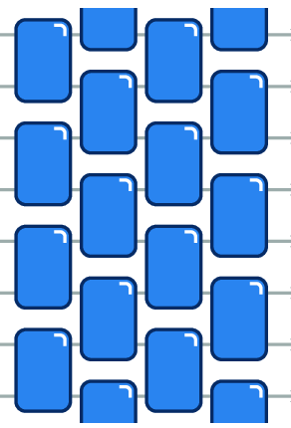
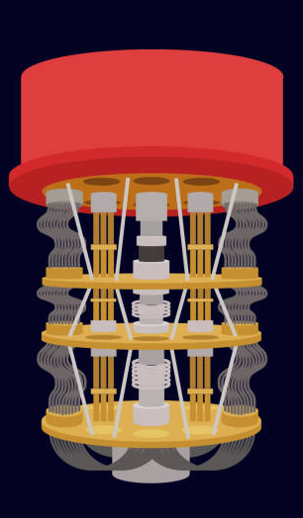
The learning task
Given as input $k$ copies of the output state $\left|C\right\rangle =C|0^{n}⟩$of an unknown circuit $C$, output the description of a circuit $D$ where $\left|D\right\rangle ≈|C⟩$.
Circuit description $C$
$${\left|C\right\rangle }^{⊗k}$$
Circuit description $D$
Alice
Bob

Slide 6
A learning algorithm for shallow depth
Current state-of-the-art (Landau, Liu 2024)
If the original circuit $C$ has depth $d$ and is on $2$-dim lattice, then there is a quantum algorithm that outputs a depth-$5d$ circuit $D$ such that $\left|C\right\rangle ≈|D⟩$ using $k=O\left(n^{5}\right)⋅2^{O\left(d^{2}\right)}$ copies of $|C⟩$, and has running time $T={\left(nd\right)}^{O(d^{3})}$.
When $d=O(1)$ the sample and time complexities scale as $poly(n)$.
When $d=O(\sqrt{\log{n}})$ the sample complexity is $poly\left(n\right)$, but the time complexity is quasipolynomial.
Beyond this, both sample/time complexities grow faster than any polynomial.

Slide 7
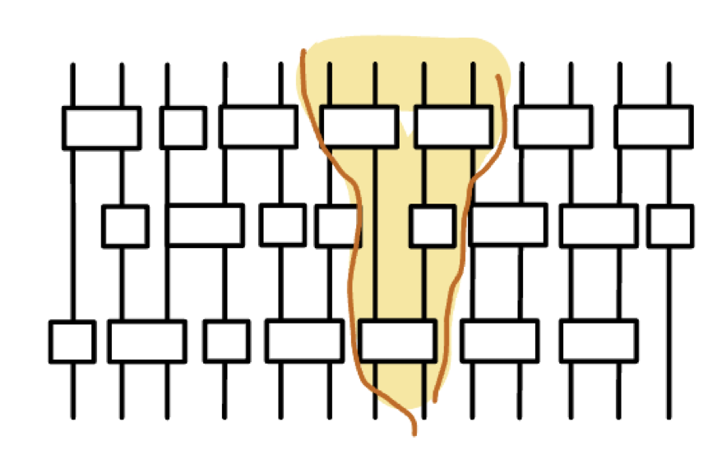
Key technique: local inversions
Key idea #1: “lightcones” in shallow circuits are small.
In depth-$d$ circuit on dim-$k$ lattice, lightcones have size $O(d^{k})$.
Key idea #2: In a state generated by a shallow-depth circuit, can disentangle some qubits by applying small “local inversion” subcircuit.
Yunchao Liu (2024)

Slide 8
Key technique: local inversions
Key idea #1: “lightcones” in shallow circuits are small.
In depth-$d$ circuit on dim-$k$ lattice, lightcones have size $O(d^{k})$.
Key idea #2: In a state generated by a shallow-depth circuit, can disentangle some qubits by applying small “local inversion” subcircuit.
Yunchao Liu (2024)

Slide 9
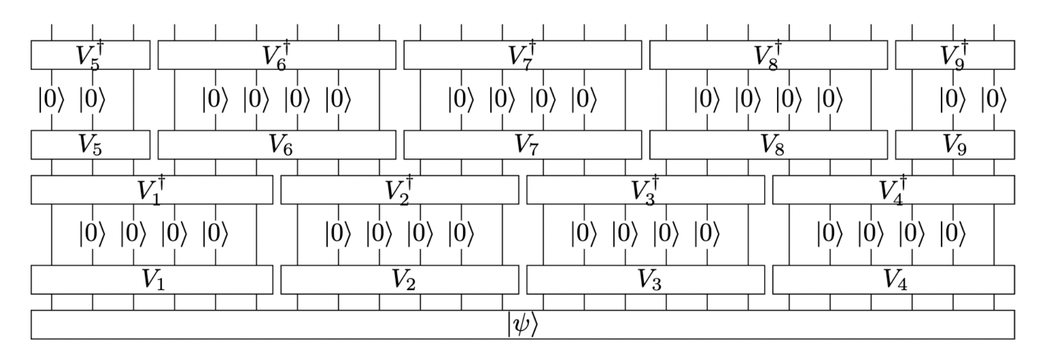
Key technique: local inversions
Key idea #1: “lightcones” in shallow circuits are small.
In depth-$d$ circuit on dim-$k$ lattice, lightcones have size $O(d^{k})$.
Key idea #2: In a state generated by a shallow-depth circuit, can disentangle some qubits by applying small “local inversion” subcircuit.
Yunchao Liu (2024)

Slide 10
Key technique: local inversions
The algorithms of Landau-Liu/Huang, et al. follow this recipe:
Brute-force search to identify local inversions of the state.
Sew the local inversions together to form a circuit for the global state.
The running time includes brute-force search for local inversions (which has size at least $O(d^{k})$) and therefore the search takes at least $2^{O(d^{k})}$ time.
When the depth $d≫\log{n}$, the search space for local inversions seems prohibitively large. Not so easy to imagine an algorithm to learn circuits with large depth…

Slide 11
Computational No-Learning Conjecture
The Computational No-Learning Conjecture
There is no polynomial-time quantum algorithm $A$ that can do the following: given $k=poly(n)$ copies of the output state $\left|C\right\rangle$of a randomly sampled circuit $C$ with depth $d≫\log{n}$, outputs the description of a circuit $D$ where $$\operatorname{Pr}\left[\left|C\right\rangle ≈|D⟩\right]≥99\%$$

Slide 12
Computational No-Learning Conjecture
The $(ε,δ)$-Computational No-Learning Conjecture
There is no polynomial-time quantum algorithm $A$ that can do the following: given $k=poly(n)$ copies of the output state $\left|C\right\rangle$of a randomly sampled circuit $C$ with depth $d≫\log{n}$, outputs the description of a circuit $D$ where $$\operatorname{Pr}\left[\text{fidelity}\left(\left|C\right\rangle ,|D⟩\right)≥ε\right]≥δ$$

Slide 13
Learning via brute force
There is a brute force quantum algorithm that given ${\left|C\right\rangle }^{⊗poly(n)}$ can learn an approximation $D$, where $C$can have depth $d=poly\left(n\right)$.
Performing standard tomography requires at least $2^{n}$ copies of $|C⟩$, but can take advantage of the special fact that $|C⟩$ was generated by a polynomial-size circuit.
Idea: use shadow tomography. Only need $poly(n)$ copies of $|C⟩$.
Measure each copy of $|C⟩$ using a random Clifford to get a classical dataset. Given exponential time, an approximation $D$ can be computed from the classical dataset.

Slide 14
No-Learning is a computational assumption
Like the P $≠$ NP conjecture, No-Learning Conjecture is about the limits of polynomial-time computation.
Like the P $≠$ NP conjecture, No-Learning Conjecture is not (yet) proven. It seems very difficult given our knowledge of complexity theory: if No-Learning Conjecture is true, then P $≠$ PSPACE.
While easier than P vs NP, we currently have no viable approaches to proving this either.

Slide 15
No-Learning is a computational assumption
P $≠$ NP
No-Learning Conjecture
P $≠$ PSPACE
We are here

Slide 16
Evidence for the No-Learning Conjecture
We can’t prove the No-Learning Conjecture, but we can try to give evidence for it.
Evidence #1: Analyzing best-known learning algorithms
The recently circuit-learning algorithms (Landau-Liu 2024, Huang, et al. 2024, Fefferman-Ghosh-Zhan 2024) are based on algorithmic ideas that appear to have an inherent exponential dependence on the depth of the circuit.

Slide 17
Evidence for the No-Learning Conjecture
We can’t prove the No-Learning Conjecture, but we can try to give evidence for it.
Evidence #2: Black-box lower bounds
If we model polynomial-sized circuits as black-boxes that prepare Haar-random-looking states, then solving the learning task requires exponential time.

Slide 18
Evidence for the No-Learning Conjecture
We can’t prove the No-Learning Conjecture, but we can try to give evidence for it.
Evidence #3: Hardness from post-quantum cryptography
Assuming that RingLWE cannot be efficiently solved by a quantum computer, then the Computational No-Learning Conjecture holds. (Zhang, et al 2023).
The hardness of RingLWE might be believable, but mathematically speaking it is a much more difficult conjecture.

Slide 19
RingLWE is hard
P $≠$ NP
No-Learning Conjecture
P $≠$ PSPACE
We are here

Slide 20
The foundations of quantum cryptography

Slide 21
The landscape of classical cryptography
Pseudorandom number generator
Oblivious transfer
Trapdoor one-way function
Indistinguishability obfuscation
Pseudorandom function
One-way
function
Primitives
Less sophisticated
More sophisticated
Functionalities
Public-key encryption
(e.g., RSA, Kyber, ..)
Private-key encryption (e.g., AES)
Digital
signatures
Fully homomorphic encryption
One-time pad
Encryption
Secure multiparty computation
Zero-knowledge proofs
Key distribution
Identity-based encryption
Bit commitments
Information-theoretic crypto
Minicrypt
Cryptomania

Slide 22
Cryptography in a quantum world
Pseudorandom number generator
Oblivious transfer
Trapdoor one-way function
Indistinguishability obfuscation
Pseudorandom function
One-way
function
Primitives
Less sophisticated
More sophisticated
Functionalities
Public-key encryption
(e.g., RSA, Kyber, ..)
Private-key encryption (e.g., AES)
Digital
signatures
Fully homomorphic encryption
One-time pad
Encryption
Secure multiparty computation
Zero-knowledge proofs
Key distribution
Identity-based encryption
Bit commitments
Information-theoretic crypto
Minicrypt
Cryptomania

Slide 23
Cryptography in a quantum world
Quantum
Oblivious transfer
One-way state generators
(Classical)
One-way
function
EFI pairs
Pseudorandom states
Primitives
Less sophisticated
More sophisticated
Functionalities
Quantum multiparty computation
Quantum
Private-key encryption
Quantum Digital
signatures
One-time pad
Encryption
Quantum commitments
Quantum
Key distribution
Information-theoretic crypto
Minicrypt
Microcrypt
Cryptomania

Slide 24
Cryptography in a quantum world
Quantum
Oblivious transfer
One-way state generators
(Classical)
One-way
function
EFI pairs
Pseudorandom states
Primitives
Less sophisticated
More sophisticated
Functionalities
Quantum multiparty computation
Quantum
Private-key encryption
Quantum Digital
signatures
One-time pad
Encryption
Quantum
Key distribution
Quantum commitments
What computational assumptions are
required here?
Requires P $≠$ NP
Information-theoretic crypto
Microcrypt
Minicrypt

Slide 25
New quantum foundations for crypto
Exciting possibility that we can base quantum crypto on fewer mathematical conjectures than what is needed for classical crypto.
Kretschmer, Qian, Sinha, Tal (2023): Evidence that many quantum cryptographic functionalities can remain secure even in a world where P = NP
There is a far reaching conjecture of Aaronson and Kuperberg, known as the Unitary Synthesis Conjecture, that would essentially imply that security of Microcrypt is immune to any collapse of classical complexity classes.

Slide 26
New frontier, new questions
Which functionalities/primitives are equivalent to each other in the quantum world? Which ones are strictly stronger than others?
Is there a minimal complexity assumption in quantum crypto?
What kind of functionalities can only be achieved with a quantum computer?
What is the computational complexity of breaking various quantum cryptographic primitives?
Can Microcrypt be concretely realized?

Slide 27
New frontier, new questions
Which functionalities/primitives are equivalent to each other in the quantum world? Which ones are strictly stronger than others?
Is there a minimal complexity assumption in quantum crypto?
What kind of functionalities can only be achieved with a quantum computer?
What is the computational complexity of breaking various quantum cryptographic primitives?
Can Microcrypt be concretely realized?

Slide 28
Generic vs concrete assumptions
Generic assumption: stipulates the existence of a secure primitive.
Example: Assume there exists a one-way function. Then there exist private-key encryption, digital signatures, etc.
Concrete assumption: stipulates that a specific computational problem is hard.
Example: Assume that it is hard to compute $g^{ab}$ given $g^{a},g^{b}$ in $ℤ_{q}$. Then public-key cryptography is possible.

Slide 29
Generic vs concrete assumptions
Generic assumption: stipulates the existence of a secure primitive.
Example: Assume there exists a one-way function. Then there exist private-key encryption, digital signatures, etc.
Concrete assumption: stipulates that a specific computational problem is hard.
Example: Assume that it is hard to compute $g^{ab}$ given $g^{a},g^{b}$ in $ℤ_{q}$. Then public-key cryptography is possible.
Ultimately, if we care about the functionalities in the real world, concrete assumptions are what matter!

Slide 30
Quantum crypto from hardness of learning

Slide 31
Crypto from the No-Learning Assumption
Under the Computational No-Learning Assumption, there exists secure 1. One-way state generators
2. One-time digital signatures
3. Quantum bit commitments
4. Secure multi-party computation
Computational No-Learning implies secure quantum cryptography

Slide 32
Crypto from the No-Learning Assumption
Under the Computational No-Learning Assumption, there exists secure 1. One-way state generators
2. One-time digital signatures
3. Quantum bit commitments
4. Secure multi-party computation
Computational No-Learning implies secure quantum cryptography
A digital signature scheme is a cryptographic method to prove authenticity of a message to a third party.

Slide 33
RandomCircuitSig
The quantum digital signature scheme for a single bit (for simplicity).
$$C_{0},C_{1}$$
Alice
Alice chooses two circuits $C_{0},C_{1}$ as her secret key.

Slide 34
RandomCircuitSig
The quantum digital signature scheme for a single bit (for simplicity).
Def: $$\left|C_{b}\right\rangle =C_{b}|0^{n}⟩$$
$$C_{0},C_{1}$$
$${\left|C_{0}\right\rangle }^{⊗k},{\left|C_{1}\right\rangle }^{⊗k}$$
Alice
Alice generates $k$ copies of the output states $\left|C_{0}\right\rangle ,|C_{1}⟩$ as her public key.

Slide 35
RandomCircuitSig
Qoogle
$$C_{0},C_{1}$$
$${\left|C_{0}\right\rangle }^{⊗k},{\left|C_{1}\right\rangle }^{⊗k}$$
Alice
Alice uploads the quantum public keys to the quantum internet.

Slide 36
RandomCircuitSig
Qoogle
$${\left|C_{0}\right\rangle }^{⊗k},{\left|C_{1}\right\rangle }^{⊗k}$$
$$C_{0},C_{1}$$
$$b,C_{b}$$
Alice
Bob
Alice sends a bit $b$ to Bob. She signs it by providing the circuit description $C_{b}$.

Slide 37
RandomCircuitSig
Qoogle
$${\left|C_{0}\right\rangle }^{⊗k−1},{\left|C_{1}\right\rangle }^{⊗k−1}$$
$$|C_{b}⟩$$
$$C_{0},C_{1}$$
Alice
Bob
$$b,C_{b}$$
To verify, Bob downloads a copy of $|C_{b}⟩$ from the quantum internet.

Slide 38
RandomCircuitSig
Qoogle
$${\left|C_{0}\right\rangle }^{⊗k−1},{\left|C_{1}\right\rangle }^{⊗k−1}$$
$$C_{0},C_{1}$$
?
$$C_{b}^{† }\left|C_{b}\right\rangle =|0^{n}⟩$$
Alice
Bob
$$b,C_{b}$$
Bob applies $C_{b}^{† }$ to the copy $|C_{b}⟩$, and checks if he gets all zeroes. If so, he accepts. Otherwise, he rejects.

Slide 39
RandomCircuitSig
Qoogle
$${\left|C_{0}\right\rangle }^{⊗k},{\left|C_{1}\right\rangle }^{⊗k}$$
$$C_{0},C_{1}$$
$$b,C_{b}$$
Alice
Bob
Suppose an adversary wants to tamper with Alice’s message and signature.

Slide 40
RandomCircuitSig
Qoogle
$${\left|C_{0}\right\rangle }^{⊗k−t},{\left|C_{1}\right\rangle }^{⊗k−t}$$
$${\left|C_{0}\right\rangle }^{⊗t},{\left|C_{1}\right\rangle }^{⊗t}$$
$$C_{0},C_{1}$$
$$b,C_{b}$$
Alice
Bob
The adversary can download copies of the public key from the quantum internet.

Slide 41
RandomCircuitSig
$$C_{0},C_{1}$$
???
$$b,C_{b}$$
$$1−b,D$$
$${\left|C_{0}\right\rangle }^{⊗t},{\left|C_{1}\right\rangle }^{⊗t}$$
Alice
Bob
From these copies of the public key, can the adversary create a signature $D$such that $\left|D\right\rangle ≈|C_{1−b}⟩$, and Bob would verify the opposite bit?

Slide 42
RandomCircuitSig
Under the Computational No-Learning Assumption, an adversary cannot efficiently produce a valid signature of the opposite bit.
$$C_{0},C_{1}$$
$$b,C_{b}$$
$$1−b,D$$
$${\left|C_{0}\right\rangle }^{⊗t},{\left|C_{1}\right\rangle }^{⊗t}$$
Alice
Bob

Slide 43
RandomCircuitSig
$$C_{0},C_{1}$$
$$\left|C_{b}\right\rangle$$
Alice
Bob
$$b,D$$
Suppose Bob receives $b,D$ from Alice (allegedly).

Slide 44
RandomCircuitSig
$$C_{0},C_{1}$$
?
$$D^{†}\left|C_{b}\right\rangle =|0^{n}⟩$$
Alice
Bob
$$b,D$$
If the verification procedure passes, then Bob can trust that the message/signature pair came from Alice.

Slide 45
RandomCircuitSig
RandomCircuitSig is an adaptation of a protocol by Morimae and Yamakawa (2022), itself a quantum generalization of the famous 1979 Lamport digital signature scheme in classical cryptography.
In classical cryptography, secure (classical) signatures are equivalent to existence of one-way functions. In particular, if P = NP, then any classical signature scheme is broken.
The security of the quantum signature scheme appears to be on firmer ground: even if P = NP, the scheme should still be secure!

Slide 46
RandomCircuitSig
Lamport’s signature scheme and RandomCircuitSig satisfy one-time security, meaning that Alice has to generate a new public key each time she wants to sign a new message.
In classical cryptography, Lamport signatures can be upgraded to many-time security. It is open how to achieve this for quantum digital signatures (without relying on one-way functions).
Mutreja, Coladangelo 2024: Many-time secure quantum signatures cannot be generically obtained from pseudorandom states.

Slide 47
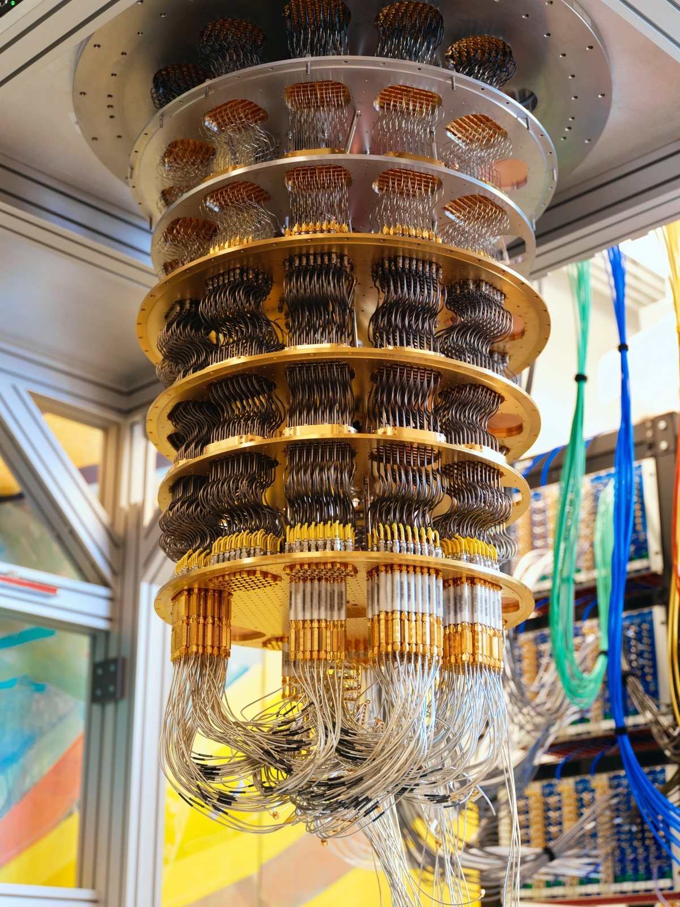
Experimental quantum crypto?
Random circuit experiments have recently been in vogue, starting with Google’s quantum supremacy experiment in 2019.
A major open question: find a computational task that
Exhibits quantum advantage
Can be implemented on a NISQ computer
Is useful (besides being a supremacy experiment)

Slide 48
Experimental quantum crypto?
Scott Aaronson was the first to propose a (provably) useful application of random circuit sampling: generating certifiable random numbers.
However, a major drawback of his proposal is that, while the random number generation is efficient, certifying the randomness requires exponential-time classical resources.
RandomCircuitSig suggests an intriguing possibility: a near-term demonstration of quantum cryptographic advantage.

Slide 49
What about noise?
Alice chooses circuits $C_{0},C_{1}$ as her secret key.
Alice prepares copies of $\left|C_{0}\right\rangle ,|C_{1}⟩$ as her public key.
To sign message bit $b$, Alice sends circuit description $C_{b}$.
To verify message/signature pair $(b,D)$, Bob obtains public key $|C_{b}⟩$, computes $D^{†}\left|C_{b}\right\rangle$, and checks if all zeroes.
RandomCircuitSig
Sources of error:
Alice’s preparation of $\left|C_{0}\right\rangle ,|C_{1}⟩$, and storage
Bob’s computation of $D^{†}\left|C_{b}\right\rangle$
Even if there is no adversary, Bob’s verification may fail with high probability!

Slide 50
What about noise?
Parameters: fidelity $η$, slack $δ$, number of repetitions $r$
Alice and Bob run $r$ independent instances of RandomCircuitSig.
To sign bit $b$, Alice will send $r$ independent signatures.
To verify, Bob will check that at least $\left(η−δ\right)r$ signatures verify correctly.
Threshold Repetition of RandomCircuitSig
$η=$ success probability of a single RandomCircuitSig verification.
$δ=$ leeway allowed due to shot noise

Slide 51
What about noise?
Parameters: fidelity $η$, slack $δ$, number of repetitions $r$
Alice and Bob run $r$ independent instances of RandomCircuitSig.
To sign bit $b$, Alice will send $r$ independent signatures.
To verify, Bob will check that at least $\left(η−δ\right)r$ signatures verify correctly.
Threshold Repetition of RandomCircuitSig
Under the $(ε,δ)$-No-Learning Assumption where $ε,δ≪η$, the Threshold Repetition is also a secure quantum signature scheme (even against noiseless adversaries).
This requires proving a ”Computational Chernoff Bound” for quantum signature schemes.

Slide 52
An experimental proposal?
(If this is too much to ask for, then can simulate the 2 parties on a single chip, for starters)
Ingredients:
Two noisy quantum computers (called “Alice” and “Bob”)
A quantum network
Proposal: Alice and Bob run the Threshold Repetition protocol; Alice signs a random bit $b$ and asks Bob to verify.
Under the hood: Alice and Bob are really performing a distributed version of randomized benchmarking: Alice generates random circuit states, Bob uncomputes them and checks how often they end up all zeroes.

Slide 53
An experimental proposal?
From Google’s 2023 paper: $η={10}^{−3}$ for $67$-qubit, depth-$32$ circuit.
More generally: $η∼\exp\left(−εnd\right)$ where $ε=$ error/gate, $n=$ # qubits, $d=$ depth.
Back-of-the-envelope calculation: for $67$-qubit, depth-$15$ circuit, the fidelity should be like $η∼4.7\%$.
Thus, setting $r=100$ in the Threshold Repetition scheme, Alice’s public key is $6700$ qubits, and Bob will check that roughly $4\%$ of the repetitions succeed.
Assuming these estimates, Bob’s verification will succeed with high probability.

Slide 54
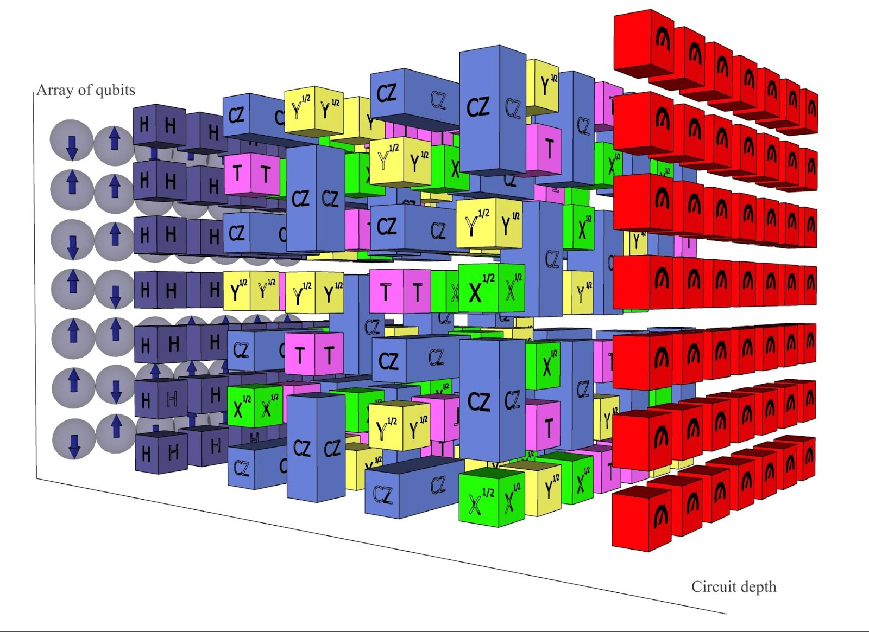
An experimental proposal?
How secure is this protocol? This depends on the assumed hardness of learning random $67$-qubit, depth-$15$ circuits.
If the circuits are 2D, then this should still be a hard task! The best algorithms need to search over local inversions of the circuit
The size of the lightcone in a 2D, depth-$15$ circuit is a large fraction of all $67$ qubits (or all, depending on the architecture). Searching over ”local” inversions of depth 15 seems prohibitively expensive.

Slide 55
Summary
The output states of random quantum circuits has been a topic of major interest lately (quantum supremacy, information scrambling, connections to quantum gravity, quantum learning, etc).
Nontrivial algorithms for learning shallow-depth quantum circuits. On the other hand, deep(er) random circuits appear to be very difficult to learn.
We use the hardness of learning random circuits to construct secure quantum cryptosystems, whose security does not rely on existence of one-way functions.

Slide 56
Summary
Functionalities and primitives obtained:
Private-key quantum money
Bit commitments
Secure multi-party computation
Zero-knowledge protocols
One-time digital signatures
Look, ma -- No one-way functions!
Basing these functionalities on random circuits yields the possibility of NISQ demonstration of quantum cryptographic advantage.

Slide 57
Next steps
Theory: What other functionalities can be obtained from hardness of learning random circuits?
What about other quantum learning assumptions? How do different assumptions compare with each other?
Can we find more theoretical evidence for hardness? Can we come up with better learning algorithms?
Experiment: Implement these functionalities on a NISQ device! Is it possible to avoid using a quantum internet?
Thank You!

