Slide 1
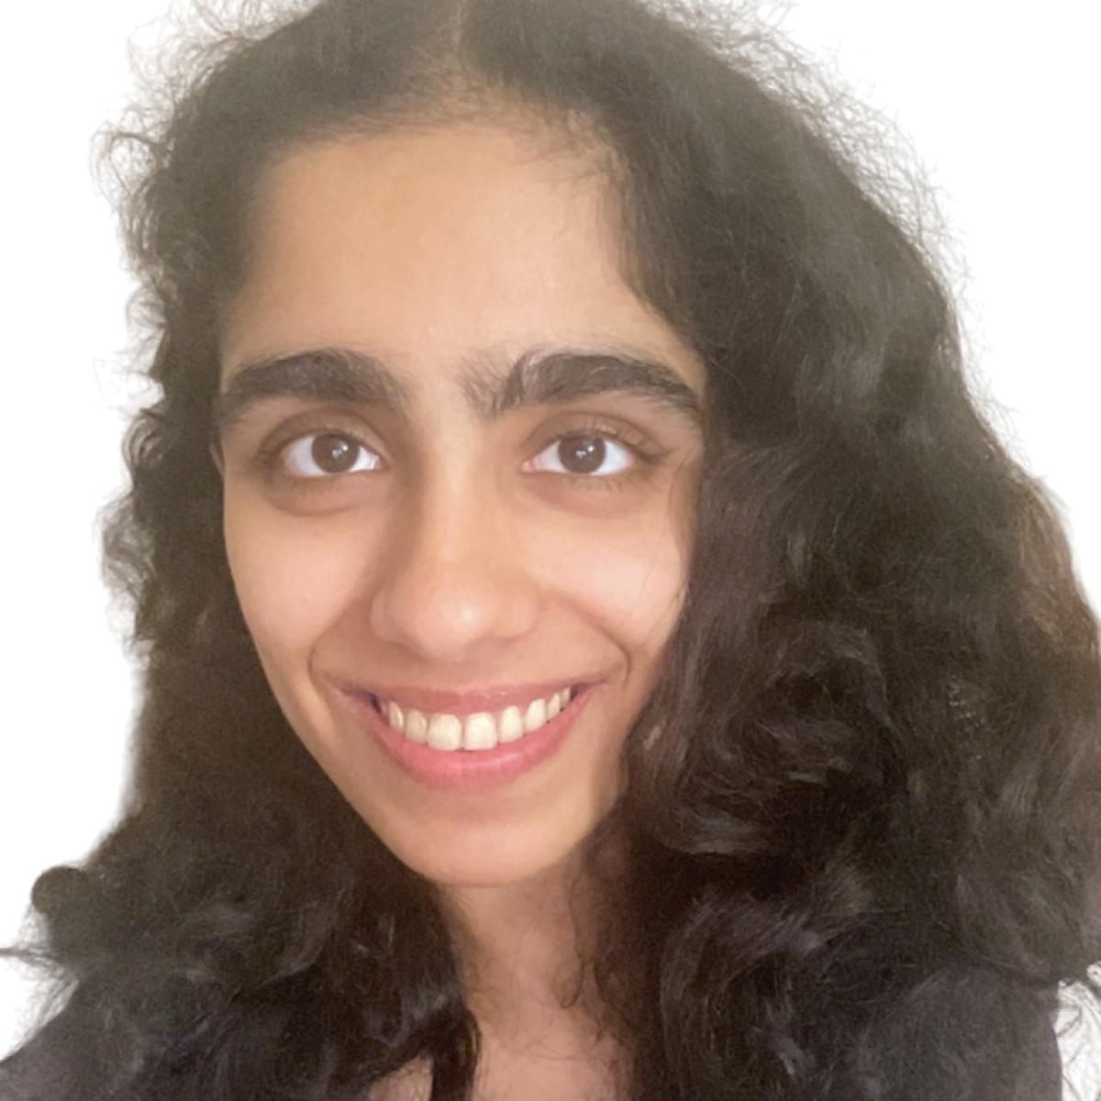
QMA vs. QCMA and Pseudorandomness
Saachi Mutreja (Columbia)
Henry Yuen (Columbia)
Jiahui Liu (MIT → Fujitsu Labs)
Notes:
Hi everyone, thank you so much for having me here. I’ll be talking about query separations between QMA vs. QCMA, which are quantum generalizations of NP, and connections with pseudorandomness. This is joint work with my wonderful collaborators: Jiahui Liu who was a postdoc at MIT but moved to Fujitsu Labs, and my student Saachi Mutreja at Columbia.
I’m not going to assume that people here are necessarily familiar with quantum computing and quantum complexity classes, so I’ll try to go slowly through the concepts here. Feel free to ask questions.

Slide 2
This talk
Main result: Distinguishing between whether an exponentially-large graph (given oracle access to it)
has two disconnected components, or
has a single expanding component
separates QMA from QCMA, assuming a quantum pseudorandomness conjecture.
This is evidence that quantum proofs can convince verifiers of more complex statements than classical proofs.

Slide 3
This talk
Main result: Distinguishing between whether an exponentially-large graph (given oracle access to it)
has two disconnected components, or
has a single expanding component
separates QMA from QCMA, assuming a quantum pseudorandomness conjecture.
The conjecture is interesting in its own right; connected to questions about:
quantum speedups for solving unstructured problems, and
the Aaronson-Ambainis conjecture about influences of low-degree bounded polynomials.

Slide 4
Quantum refresher

Slide 5
Quantum states and computation
A quantum state $|ψ⟩$ on $n$ qubits is a $2^{n}$-dimensional complex unit vector.
Analogous to a probability distribution on ${\left\{0,1\right\}}^{n}$, except the “probabilities” can be negative or even complex!
A quantum computation is some sequence of unitary transformations and measurements.
Unitary matrices: reversible state transformations. Analogous to doubly-stochastic matrices in probability theory.
Measurement: non-reversible state transformation. Analogous to taking a sample from a distribution.

Slide 6
Classical vs quantum
Unlike classical distributions, for every state $|ψ⟩$, there is an algorithm to deterministically test whether $n$ qubits are in the state $|ψ⟩$.
How much information is in a quantum state?:
Holevo’s theorem: $n$ qubits can only reliably store and retrieve $n$ classical bits.
On the other hand, sometimes quantum states appear to pack exponentially more information than classical bits, e.g., communication complexity separations.

Slide 7
Quantum generalizations of NP

Slide 8
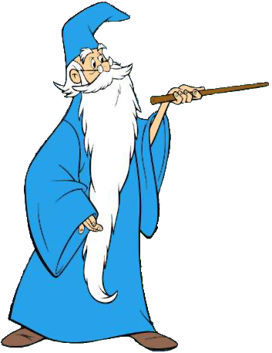
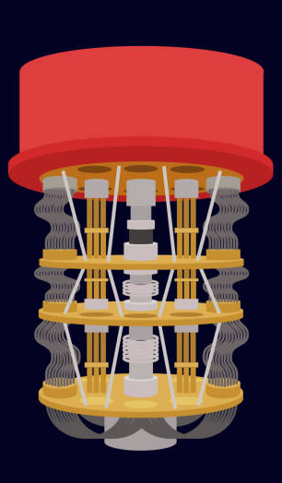
Quantum Merlin-Arthur (QMA)
Informally: QMA = problems efficiently verifiable on quantum computers with help of a quantum proof.
Formally: $L∈QMA$ iff there exists a poly-time quantum verifier $V$ such that
$x∈L$ $⟹∃$ quantum proof $|ψ⟩$ where $V(x,|ψ⟩)$ accepts w.h.p.
$x∉L$ $⟹$ all quantum proofs $\left|ψ\right\rangle$ cause $V(x,|ψ⟩)$ to reject w.h.p.
$$x$$
Accept/Reject
$$x$$
$$\left|ψ\right\rangle$$
Merlin: All-powerful, but untrusted prover
Arthur: polynomial-time quantum verifier

Slide 9
Quantum Merlin-Arthur (QMA)
Complexity landscape
PSPACE
QMA
NP
BQP

Slide 10
Quantum Merlin-Arthur (QMA)
Complexity landscape
Problems in QMA
LOCAL HAMILTONIANS: Deciding if there exists quantum state with energy $≤α$ or $≥β$ for $\left|α−β\right|≥1/poly$ (QMA-complete).
CIRCUIT EQUIVALENCE: Deciding whether two quantum circuits are equivalent (co-QMA complete).
GROUP NON-MEMBERSHIP: Deciding whether a given group element is outside of a succinctly presented subgroup (given access to group oracle).
PSPACE
QMA
NP
BQP

Slide 11
Quantum Classical Merlin-Arthur (QCMA)
Informally: QCMA = problems efficiently verifiable on quantum computers with help of a classical proof.
Formally: $L∈QCMA$ iff there exists a poly-time quantum verifier $V$ such that
$x∈L$ $⟹∃$ classical proof $w$ where $V(x,w)$ accepts w.h.p.
$x∉L$ $⟹$ all classical proofs $w$cause $V(x,w)$ to reject w.h.p.
$$x$$
$$x$$
$$w$$
Merlin: All-powerful, but untrusted prover
Arthur: polynomial-time quantum verifier

Slide 12
Quantum Classical Merlin-Arthur (QCMA)
Complexity landscape
Problems in QCMA
PSPACE
GROUND SPACE CONNECTIVITY: Given a local Hamiltonian and poly-sized descriptions of two ground states (promised that such descriptions exist), decide if there exists an “energy barrier” between the two states (QCMA complete).
GROUP NON-MEMBERSHIP: Under some group theory assumptions, this problem has a QCMA protocol.
QMA
QCMA
NP
BQP

Slide 13
QMA vs. QCMA
How useful are quantum proofs?
Although a $n$-qubit state requires $2^{n}$ parameters to specify, it can’t be used to convey more than $n$ bits of classical information, by Holevo’s theorem.
Examples of problems where quantum proofs do not appear to help:
Approximating set size
Formula unsatisfiability
Certifying that a black-box function is 1-to-1 rather than 2-to-1.

Slide 14
QMA vs. QCMA
If QMA = QCMA, quantum proofs can be efficiently replaced by classical proofs.
Consequences:
Ground states of local Hamiltonians have efficiently checkable classical descriptions. This implies that physically-relevant quantum systems have ground states with limited complexity.
If two quantum circuits behave differently, then there is a polynomial-size classical witness of this fact.

Slide 15
QMA vs. QCMA
If QMA ≠ QCMA, then quantum proofs allow for verification of more complex statements than classical proofs.
Unconditionally separating QCMA from QMA is, of course, difficult.
The next best thing is to find oracle evidence that they are different.

Slide 16
Oracle separations of QMA from QCMA

Slide 17
Oracle QMA and QCMA
We consider oracle models of QMA and QCMA where the input to the verifier is an oracle which must be queried.
Complexity parameters measured in terms of oracle size
# of queries made by verifier
size of proof received by verifier
oracle
The verifier’s task is to decide whether the oracle satisfies some property.
$$|ψ⟩$$

Slide 18
Oracle QMA and QCMA
sets of oracles
An QMA/QCMA oracle separation is a decision problem $\left(ℒ_{YES},ℒ_{NO}\right)$ where
There exists QMA verifier $V$ that decides $\left(ℒ_{YES},ℒ_{NO}\right)$ using $polylog(N)$ queries and proof size
Any QCMA verifier needs at least $poly(N)$ queries and proof size.
$N$ = oracle size
Such a separation provides a setting where quantum proofs are more powerful than classical proofs.
oracle
$$|ψ⟩$$

Slide 19
Oracle QMA and QCMA
There is a unitary oracle separating QMA from QCMA (Aaronson, Kuperberg 2007)
The oracle decision problem: decide if $U=I$ or $U=I−2\left|ψ\right\rangle \left\langle ψ\right|$ for some $|ψ⟩$, promised one is the case.
QMA upper bound: prover sends $|ψ⟩$, and verifier can query oracle to check.
oracle
QCMA lower bound bound: if $\left|ψ\right\rangle$ is uniformly random, by concentration of measure, QCMA verifier cannot distinguish $U=I−2\left|ψ\right\rangle ⟨ψ|$ from $U=I$ without exponentially many queries.
$$|ψ⟩$$

Slide 20
Oracle QMA and QCMA
Aaronson and Kuperberg asked if there is a classical oracle separation. A classical oracle is a function $f:[N]→[M]$ queryable in superposition:
$$\sum_{x}{α_{x}\left|x\right\rangle |0⟩}↦\sum_{x}{α_{x}\left|x\right\rangle |f(x)⟩}$$
Partial progress over the years:
Lutomirski 2011
Fefferman, Kimmel 2015
Natarajan, Nirkhe 2022
Bassirian, Fefferman, Marwaha 2022
Ben-David, Kundu 2024
Li, Liu, Pelecanos, Yamakawa 2024
Assume restrictions on oracle model or on verifier

Slide 21
Oracle QMA and QCMA
Aaronson and Kuperberg asked if there is a classical oracle separation. A classical oracle is a function $f:[N]→[M]$ queryable in superposition:
$$\sum_{x}{α_{x}\left|x\right\rangle |0⟩}↦\sum_{x}{α_{x}\left|x\right\rangle |f(x)⟩}$$
Partial progress over the years:
Lutomirski 2011
Fefferman, Kimmel 2015
Natarajan, Nirkhe 2022
Bassirian, Fefferman, Marwaha 2022
Ben-David, Kundu 2024
Li, Liu, Pelecanos, Yamakawa 2024
Separations based on graph problems

Slide 22
Oracle QMA and QCMA
Aaronson and Kuperberg asked if there is a classical oracle separation. A classical oracle is a function $f:[N]→[M]$ queryable in superposition:
$$\sum_{x}{α_{x}\left|x\right\rangle |0⟩}↦\sum_{x}{α_{x}\left|x\right\rangle |f(x)⟩}$$
Proposed the Components problem as a candidate QMA/QCMA oracle separation
Partial progress over the years:
Lutomirski 2011
Fefferman, Kimmel 2015
Natarajan, Nirkhe 2022
Bassirian, Fefferman, Marwaha 2022
Ben-David, Kundu 2024
Li, Liu, Pelecanos, Yamakawa 2024
Showed that a randomized-oracle variant of the problem separates QMA/QCMA.

Slide 23
$F:\left[R\right]×\left[N\right]→\left[N\right]$ is a graph oracle if it defines a matching for every color $r∈\left[R\right]$, i.e., $F\left(r,x\right)=y⇔F\left(r,y\right)=x$.
The Components problem
A graph oracle $F:\left[R\right]×\left[N\right]→\left[N\right]$ is a
YES instance if the corresponding graph can be partitioned into two components of size $N/2$.
NO instance if the corresponding graph is a $Δ$-expander
In particular, NO instances are a single component that is highly connected.
Think of $Δ=Ω\left(1\right), R=O\left(1\right), N=2^{n}$.

Slide 24
QMA protocol for Components
$$\left|ψ\right\rangle =\frac{1}{\sqrt{N}}\left(\sum_{x∈S}{|x⟩}−\sum_{x∉S}{|x⟩}\right)$$
Intended quantum proof:
Quantum state on $n=\log{N}$ qubits
Perform one of two tests at random:
1. Balancedness test: check that $|ψ⟩$ is orthogonal to $\frac{1}{\sqrt{N}}\sum_{x∈[N]}{|x⟩}$.
2. Expansion test: pick a random color $r∈[R]$. Check that $|ψ⟩$ is invariant under permuting the vertices according to the matching $F(r,⋅)$.
For YES graph oracles $F$, there is balanced partition $\left[N\right]=S∪\overline{S}$ and no edges cross the partition.
$$S$$
$$\overline{S}$$

Slide 25
QMA protocol for Components
$$\left|ψ\right\rangle =\frac{1}{\sqrt{N}}\left(\sum_{x∈S}{|x⟩}−\sum_{x∉S}{|x⟩}\right)$$
Intended quantum proof:
QMA verifier, on input $|ψ⟩$
Perform one of two tests at random:
1. Balancedness test: check that $|ψ⟩$ is orthogonal to $\frac{1}{\sqrt{N}}\sum_{x∈[N]}{|x⟩}$.
2. Expansion test: pick a random color $r∈[R]$. Check that $|ψ⟩$ is invariant under permuting the vertices according to the matching $F(r,⋅)$.

Slide 26
QMA protocol for Components
$$\left|ψ\right\rangle =\frac{1}{\sqrt{N}}\left(\sum_{x∈S}{|x⟩}−\sum_{x∉S}{|x⟩}\right)$$
Intended quantum proof:
Checks that $|ψ⟩$ specifies a balanced partition of vertices.
QMA verifier, on input $|ψ⟩$
Perform one of two tests at random:
1. Balancedness test: check that $|ψ⟩$ is orthogonal to $\frac{1}{\sqrt{N}}\sum_{x∈[N]}{|x⟩}$.
2. Expansion test: pick a random color $r∈[R]$. Check that $|ψ⟩$ is invariant under permuting the vertices according to the matching $F(r,⋅)$.

Slide 27
QMA protocol for Components
$$\left|ψ\right\rangle =\frac{1}{\sqrt{N}}\left(\sum_{x∈S}{|x⟩}−\sum_{x∉S}{|x⟩}\right)$$
Intended quantum proof:
QMA verifier, on input $|ψ⟩$
Perform one of two tests at random:
1. Balancedness test: check that $|ψ⟩$ is orthogonal to $\frac{1}{\sqrt{N}}\sum_{x∈[N]}{|x⟩}$.
2. Expansion test: pick a random color $r∈[R]$. Check that $|ψ⟩$ is invariant under permuting the vertices according to the matching $F(r,⋅)$.
Checks not many edges cross the cut specified by $|ψ⟩$.

Slide 28
QCMA lower bound for Components
Main Theorem (Liu, Mutreja, Y.)
Assuming a quantum pseudorandomness conjecture, any QCMA protocol for Components must either make $N^{Ω(1)}$ queries to the graph oracle $F$, or receive a classical witness of length $N^{Ω\left(1\right)}$.
In contrast: QMA verifier makes 1 query and receives $O(\log{N)}$-qubit witness.

Slide 29
Quantum Pseudorandomness Conjectures

Slide 30
Dense distributions
Definition: A random variable $X$over ${\{0,1\}}^{N}$ is $δ$-dense if for all subsets $S⊆[N]$ of coordinates,
$$H_{min}\left(X_{S}\right)≥\left(1−δ\right)⋅\left|S\right|$$
$1−δ$ fraction of maximum entropy

Slide 31
Dense distributions
Definition: A random variable $X$over ${\{0,1\}}^{N}$ is $δ$-dense if for all subsets $S⊆[N]$ of coordinates,
$$H_{min}\left(X_{S}\right)≥\left(1−δ\right)⋅\left|S\right|$$
$1−δ$ fraction of maximum entropy

Slide 32
Dense distributions
Definition: A random variable $X$over ${\{0,1\}}^{N}$ is $δ$-dense if for all subsets $S⊆[N]$ of coordinates,
$$H_{min}\left(X_{S}\right)≥\left(1−δ\right)⋅\left|S\right|$$
Example: $X$ uniform over even parity strings in ${\left\{0,1\right\}}^{N}$ is $O\left(\frac{1}{N}\right)$-dense.
$1−δ$ fraction of maximum entropy

Slide 33
Warmup Pseudorandomness Conjecture
For all $T$-query quantum algorithms $A$, for all $δ$-dense distributions $F$ over ${\left\{0,1\right\}}^{N}$, $$\left|\underset{F}{Pr}\left[A^{F}=1\right]−\underset{U}{Pr}\left[A^{U}=1\right]\right|≤poly\left(T\right)⋅poly(δ)$$
where $U=$ uniform distribution over ${\left\{0,1\right\}}^{N}.$

Slide 34
Conjecture is motivated by results in classical cryptography showing that dense distributions fool few-query classical algorithms.
Theorem (Coretti, Dodis, Guo, Steinberger 2017)
For all $T$-query classical randomized algorithms $A$, for all $δ$-dense distributions $F$ over ${\left\{0,1\right\}}^{N}$,
$$\left|\underset{F}{Pr}\left[A^{F}=1\right]−\underset{U}{Pr}\left[A^{U}=1\right]\right|≤δT$$
In cryptography, this is used to argue that short advice about a random oracle cannot be helpful.

Slide 35
(Guo, Li, Liu, Zhang 2021) showed that Warmup Conjecture implies a longstanding conjecture from the late 90s.
No Quantum Speedup Conjecture
For all $T$-query quantum algorithms $A$, there exists a classical algorithm $B$ making $poly\left(T,\frac{1}{ε}\right)$ queries such that
$$\left|\underset{U}{Pr}\left[A^{U}=1\right]−\underset{U}{Pr}\left[B^{U}=1\right]\right|≤ε$$
In other words, conjecture posits there cannot be an exponential quantum speedup for “unstructured” decision problems.

Slide 36
The No Quantum Speedup Conjecture is also implied by the following:
Aaronson-Ambainis conjecture
All degree-$T$ polynomials $p:{\left\{0,1\right\}}^{N}→[0,1]$ have a coordinate $j∈[N]$ where
$$Inf_{j}\left(p\right)≥poly\left(\frac{Var(p)}{T}\right)$$
Partial progress: [OZ15, ABP19, BSdW19, Gutierrez 23, LZ23, Bhattacharya 24]
Aaronson-Ambainis conjecture is still open.

Slide 37
Warmup Pseudorandomness Conjecture, Polynomial version
(Dense distributions fool low-degree bounded polynomials)
Warmup
Pseudorandomness Conjecture
Aaronson-Ambainis Conjecture
(Low-degree bounded polynomials have an influential variable)
(Dense distributions fool quantum algorithms)
No Quantum Speedup Conjecture
(Quantum algorithms can be simulated by classical algorithms on the uniform distribution)

Slide 38
Theorem (weaker version of warmup conjecture)
For all polynomials $p:{\left\{0,1\right\}}^{N}→\left[0,1\right]$ of degree $T≪\sqrt{\log{N}}$ , for all $δ=\frac{2^{\sqrt{\log{N }}}}{N}$-dense distributions $F$ over ${\left\{0,1\right\}}^{N}$ $$\left|𝔼p\left(F\right)−𝔼p\left(U\right)\right|=o(1)$$
Proved using the Fourier tail bound of (Dinur, Friedgut, Kindler, O’Donnell ‘06).

Slide 39
Permutation oracles and distributions
We consider algorithms that query permutations $P:\left[N\right]→\left[N\right]$ and their inverses. Quantum algorithms can call the following unitary operations:
$$U_{P}:\left|x\right\rangle →\left|P\left(x\right)\right\rangle U_{P}^{−1}\left|x\right\rangle =|P^{−1}\left(x\right)⟩$$
Definition: A random permutation $P$over $[N]$ is $δ$-dense if for all subsets $S⊆[N]$ of coordinates,
$$H_{min}\left(P(S)\right)≥\left(1−δ\right)⋅\sum_{j=0}^{\left|S\right|−1}{\log{(N−j)}}$$

Slide 40
Quantum Pseudorandomness Conjecture
For all $T$-query quantum algorithms $A$, for all $δ$-dense random permutations $P:\left[N\right]→[N]$, $$\left|\underset{P}{Pr}\left[A^{P}=1\right]−\underset{U}{Pr}\left[A^{U}=1\right]\right|≤poly\left(T,\log{N}\right)⋅poly(δ)$$
where $U=$ uniformly random permutation over $[N].$
Coretti, Dodis, Guo 2018 proved this for classical algorithms, with applications to cryptography.

Slide 41
Conditionally separating QMA from QCMA

Slide 42
QCMA lower bound for Components
Main Theorem (Liu, Mutreja, Y.)
Assuming the quantum pseudorandomness conjecture, any QCMA protocol for Components must either make $N^{Ω(1)}$ queries to the graph oracle $F$, or receive a classical witness of length $N^{Ω\left(1\right)}$.
A win-win situation: either there is a classical oracle separation between QMA/QCMA, or there is quantum advantage in distinguishing dense permutations from uniform permutations.

Slide 43
Suppose QCMA verifier solved the Components problem with $T=N^{o(1)}$queries and $Q=N^{o(1)}$ proof length.
Graph oracle
vs
$$ℒ_{YES}$$
$$ℒ_{NO}$$
Proof string $w$
YES instance

Slide 44
Suppose QCMA verifier solved the Components problem with $T=N^{o(1)}$queries and $Q=N^{o(1)}$ proof length.
Graph oracle
vs
$$ℒ_{YES}$$
$$ℒ_{NO}$$
Proof string $w$
NO
instance

Slide 45
Suppose QCMA verifier solved the Components problem with $T=N^{o(1)}$queries and $Q=N^{o(1)}$ proof length.
Graph oracle
$$ℛ$$
vs
$$ℒ_{YES}$$
$$ℒ_{NO}$$
Step 1: By counting argument, there exists a proof string $w^{∗}$ that works for $2^{−Q}$ fraction of YES graphs. Hardcode that into the verifier.
Verifier with hardcoded string $w^{∗}$

Slide 46
After hardcoding, we have $T=N^{o(1)}$ query algorithm that distinguishes between $ℛ$-instances and all NO instances. We want to show this is impossible.
Graph oracle
$$ℛ$$
vs
$$ℒ_{YES}$$
$$ℒ_{NO}$$
[Ambainis, Childs, Liu ‘06]: impossible when $ℛ=ℒ_{YES}$
Verifier with hardcoded string $w^{∗}$
What about when $ℛ$ is an arbitrary $2^{−Q}$ fraction of YES instances?

Slide 47
From graphs to permutations
We can view YES graphs $F:\left[R\right]×\left[N\right]→\left[N\right]$in Components problem as functions of “raw permutations” $X,Y_{1},…, Y_{R},Z_{1},…, Z_{R}$
$$X$$
$$X(1)$$
$$⋮$$
$$X\left(N/2\right)$$
$$X\left(N/2+1\right)$$
$$⋮$$
$$X(N)$$
$$Y_{1}$$
$$Y_{1}\left(1\right)$$
$$⋮$$
$$Y_{1}\left(N/2\right)$$
$$Y_{R}$$
$$Y_{R}\left(1\right)$$
$$⋮$$
$$Y_{R}\left(N/2\right)$$
$$Z_{1}$$
$$Z_{1}\left(1\right)$$
$$⋮$$
$$Z_{1}\left(N/2\right)$$
$$Z_{R}$$
$$Z_{R}\left(1\right)$$
$$⋮$$
$$Z_{R}\left(N/2\right)$$
…
…
Specifies matchings in first component
Specifies matchings in second component
Specifies partition into two components

Slide 48
From graphs to permutations
Algorithm $A$ makes $T$ queries to a graph oracle $F$.
Oracle $F$
Algorithm $A$

Slide 49
From graphs to permutations
Equivalently, $A$ makes $O(T)$ queries to permutations $X,Y_{r},Z_{r}$, or their inverses.
$$X,X^{−1}$$
$$Y_{r},Y_{r}^{−1}$$
Oracle $F$
Algorithm $A$
$$Z_{r}, Z_{r}^{−1}$$

Slide 50
The hardcoded verifier accepts all YES graphs from $ℛ$, which by previous graph/permutation correspondence can be viewed as a subset of density $2^{−Q}$ in the space of all permutations $\left(X,Y_{1},…,Y_{R},Z_{1},…, Z_{R}\right)$.
Key Insight 1
$ℛ≈$ convex combination of distributions over permutation tuples $\left(X,Y_{1},…,Y_{R},Z_{1},…, Z_{R}\right)$ where
$≈Q$ coordinates are fixed
Dense everywhere else
This uses min-entropy decomposition lemma from communication complexity, extension complexity lower bounds, and cryptography.

Slide 51
The hardcoded verifier accepts all YES graphs from $ℛ$, which by previous graph/permutation correspondence can be viewed as a subset of density $2^{−Q}$ in the space of all permutations $\left(X,Y_{1},…,Y_{R},Z_{1},…, Z_{R}\right)$.
Key Insight 2
$$66$$
$$8$$
The Quantum Pseudorandomness Conjecture implies hardcoded verifier cannot distinguish between $ℛ$ and a (convex combination of) uniformly random YES graph oracle conditioned on $≈Q$ fixed edges/vertices.
$$2$$
$$7$$
$$5$$
$$11$$
$$1$$
$$117$$
A YES instance with some fixed vertices and edges.

Slide 52
The jardcoded verifier makes $T$ queries, takes no proof, and distinguishes between
a uniformly random YES graph oracle with a fixed structure of size $N^{o(1)}$
every NO graph oracle.
Lemma
This implies there is a quantum algorithm $W$ making $N^{o(1)}$ queries and solves the average-case Components problem (with no fixed structures!).
This contradicts (Ambainis, Childs, and Liu 2011) who proved that solving the average-case Components problem requires $Ω(N^{1/4})$ queries.
QED

Slide 53
Warmup Pseudorandomness Conjecture, Polynomial version
Quantum Pseudorandomness Conjecture
Warmup Pseudorandomness Conjecture
(Dense random permutations fool quantum algorithms)
Aaronson-Ambainis Conjecture
(Dense random functions fool quantum algorithms)
Classical oracle separation of QMA from QCMA
No Quantum Speedup Conjecture

Slide 54
Warmup Pseudorandomness Conjecture, Polynomial version
Quantum Pseudorandomness Conjecture
?
Warmup Pseudorandomness Conjecture
(Dense random permutations fool quantum algorithms)
Aaronson-Ambainis Conjecture
(Dense random functions fool quantum algorithms)
Classical oracle separation of QMA from QCMA
No Quantum Speedup Conjecture

Slide 55
Warmup Pseudorandomness Conjecture, Polynomial version
Quantum Pseudorandomness Conjecture
?
Warmup Pseudorandomness Conjecture
(Dense random permutations fool quantum algorithms)
Aaronson-Ambainis Conjecture
(Dense random functions fool quantum algorithms)
Classical oracle separation of QMA from QCMA
No Quantum Speedup Conjecture

Slide 56
Warmup Pseudorandomness Conjecture, Polynomial version
Quantum Pseudorandomness Conjecture
Warmup Pseudorandomness Conjecture
(Dense random permutations fool quantum algorithms)
Aaronson-Ambainis Conjecture
(Dense random functions fool quantum algorithms)
?
Classical oracle separation of QMA from QCMA
No Quantum Speedup Conjecture

Slide 57
Warmup Pseudorandomness Conjecture, Polynomial version
Quantum Pseudorandomness Conjecture
Warmup Pseudorandomness Conjecture
(Dense random permutations fool quantum algorithms)
Aaronson-Ambainis Conjecture
(Dense random functions fool quantum algorithms)
?
?
?
?
Classical oracle separation of QMA from QCMA
No Quantum Speedup Conjecture
?
?
?
?

Slide 58
Warmup Pseudorandomness Conjecture, Polynomial version
Quantum Pseudorandomness Conjecture
Warmup Pseudorandomness Conjecture
(Dense random permutations fool quantum algorithms)
Aaronson-Ambainis Conjecture
(Dense random functions fool quantum algorithms)
Classical oracle separation of QMA from QCMA
No Quantum Speedup Conjecture
Thank You!

